Slide 1








Dance Moves Detector
using
Pandas
School of Technology & Computing
Masters of Artificial Intelligence
Master of Computer Science
Verónica Elze
Hiromi Cota
Ixius
Procopios
Notes:
~~Verónica
“Hello everyone! Welcome to our presentation on the Dance Moves Detector, a machine learning pipeline built using Pandas to process pose estimation data.
My name is Verónica Elze, and I’m proud to be working with Hiromi Cota and Ixius Procopios—Hiromi and I are pursuing a Master of Science in Artificial Intelligence and Ixius in Computer Science here at CityU.
We’re thrilled to walk you through how we’ve used data science techniques to interpret human movement, with a long-term vision of integrating AI-powered motion into robotics, dance education, and beyond.”

Slide 2
Agenda
Project Introduction
Core Pandas Concepts
Pose Data I/O & Preprocessing
Feature Engineering & Labeling
Visualizing Movements
Pandas as ML Foundation
Notes:
~~Verónica
“This presentation is a hands-on tutorial showcasing how we used Pandas to work with pose estimation data.
We’ll cover core data structures, importing and cleaning real-world keypoints, engineering new features, labeling sequences, and visualizing movement.
By the end, you’ll see how Pandas can transform messy raw data into clean, structured input for machine learning.”

Slide 3
Overview & Use Case
Performance Analytics
Health & Rehab
Drive humanoid robot movements
Monitor physical therapy movements
Visual feedback and classification for dancers or athletes
Robotics UX
STEM Education
Motion science via data-driven recognition
Notes:
~~TM
“Our use case brings Pandas to life: we’re working with pose estimation data—coordinates of joints tracked from video frames. Think of it like capturing the rhythm of movement, then turning that into numbers.
We chose dance movements because it’s visual, data-rich, and has real-world crossovers—robotics, fitness apps, even motion capture for film. But most importantly, it gave us the chance to apply Pandas in a way that’s tactile and engaging—not just a demo on sales data or Titanic passengers. This project is about showing how technical tools can interact with human expression.”

Slide 4
Core Pandas Concepts
Notes:
~~Verónica
“Let’s start by laying the groundwork with some core Pandas concepts that powered our entire data processing pipeline.”
20-25 slides of “Introduction to Pandas Dataframe and its applications” Topics including:
Overview of the package
Data structures
Basic functionality
IO tools
Indexing and selecting data
Visualization techniques
Relation to NumPy
[20 points]

Slide 5
Pandas Introduction
Open-source Python library
Built on NumPy
Great with labeled
&
tabular data
Clean, transform, &
explore datasets
Structure output
Into
ML-ready formats
Notes:
~~TM
“Pandas is an open-source Python library designed for manipulating and analyzing structured data—think of it as a spreadsheet powerhouse for coders.
It’s built on NumPy, which means it handles large datasets with efficiency and speed, especially when you're working with numerical data like coordinates.
What makes Pandas so valuable in our project is how it handles labeled, tabular data—like rows for video frames and columns for joint positions.
It excels at cleaning, transforming, and exploring data through readable, chainable commands, which keeps our workflow both clear and reproducible.
In this project, it allowed us to organize nested pose estimation output—turning it into clean DataFrames we could work with. You’ll see this in action soon, then get to practice it directly in the tutorial.”

Slide 6
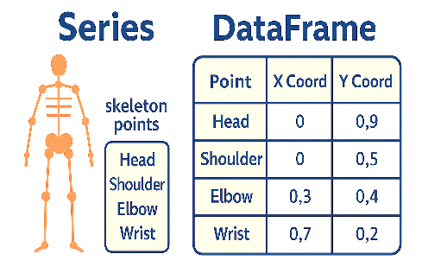
Data Structures
Series: One-dimensional labeled array Ex: Single joint’s x-coordinates across frames
DataFrame: Two-dimensional labeled table Ex: Rows = frames, Columns = joint coordinates
Index: Labels for accessing rows/columns
Built on NumPy for performance & mathematical operations
Enables vectorized operations (analysis & feature engineering)
Notes:
~~Verónica
“Let’s start with the three key data structures in Pandas, beginning with the Series. A Series is one-dimensional—it’s ideal for tracking something like the X-coordinates of a single joint over time.
Next is the DataFrame, which lets us track all joints, across multiple frames. It’s the structure we used most—each row holds a single pose, and each column represents a specific coordinate.
Then there’s the Index, which is what allows us to label and navigate those rows and columns. We relied on it for time-based slicing and segmenting sequences.
All of this is powered by NumPy under the hood—so it’s fast and memory-efficient, even with high frame counts.
And with vectorized operations, we could compute things like joint distances and velocity columns without writing loops—just a few lines of elegant code.”

Slide 7
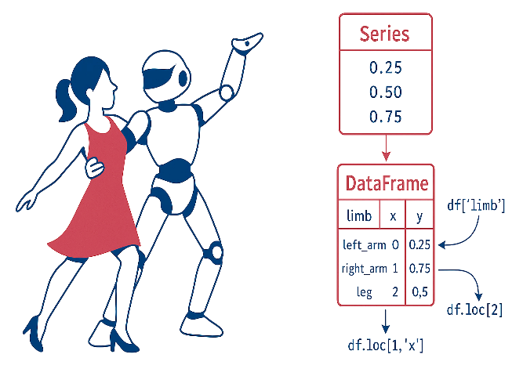
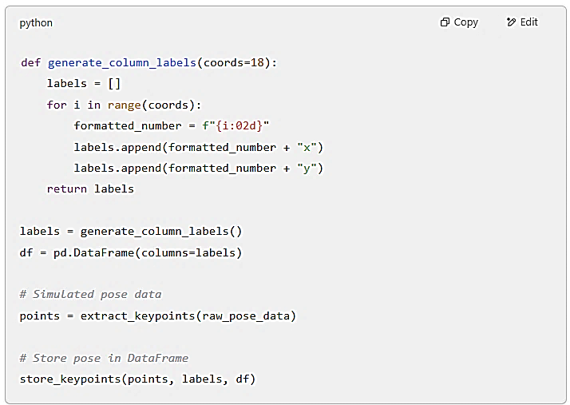
Basic Functionality
Reading data: read_json(), read_csv()
Slicing and dicing: .loc[], .iloc[], .head()
Data types and conversion: Keep joints flexible with .astype()
Sorting and filtering: Spotlight the best takes, filter out the missteps
Data summary: .describe(), .info() – your dance rehearsal notes
Notes:
~~Verónica
“Once the data was inside Pandas, we had a full toolkit to start working with it.
We began by using read_json() to load OpenPose outputs, and read_csv() to import CSV versions of our cleaned pose files. Pandas made switching between formats quick and seamless.
Then we explored and filtered the data using .head() to preview it, and .loc[] and .iloc[] to select specific rows, frames, or joints. These slicing tools gave us precise control over what part of the pose we were analyzing.
We used .astype() to convert any misread data types—like when numeric values were accidentally interpreted as strings—ensuring consistency before any calculations.
We applied sorting and filtering to focus on clean, usable frames and to remove those with corrupted or incomplete joint data.
And finally, we used .describe() and .info() to get a snapshot of the dataset—things like joint coordinate ranges, missing values, and overall structure. These methods gave us confidence that our data was ready for transformation.
We’ve included a portion of the actual code used in our Jupyter notebook. You’ll see the generate_column_labels() function create consistent labels like ‘00x’, ‘00y’, and so on. Those were used to structure our DataFrame before we inserted cleaned keypoint data row by row. You’ll write and run this same logic in the tutorial.”

Slide 8
I/O Tools
pd.read_json()
Parses OpenPose or Mediapipe JSON frames
pd.read_csv()
Save cleaned sequences for model input
Common supported
json
.xlsx
.parquet
Loads pose keypoints exported as CSV
df.to_csv() / df.to_json()
.csv
Notes:
~~Verónica
“On the previous slide, we used read_json() and read_csv() to bring pose data into Pandas. That covered input—now let’s look at what happens when we’re ready to move that data forward.
We used to_csv() and to_json() to export our cleaned DataFrame, but Pandas gives us more than just text files.
It also supports Excel files with to_excel()—useful when collaborating with non-programmers—and Parquet files with to_parquet() for highly efficient, compressed storage.
Adding these to your toolbox means your Pandas workflow isn’t just good for data prep—it’s fully modular and scalable. Whether you're saving for version control, staging for machine learning, or sharing with another team, you’ve got options that match the format to the audience and the task.”

Slide 9
Data Handling
Notes:
“Now that our data is loaded and structured, let’s talk about how we cleaned it and prepared it for meaningful analysis.”

Slide 10
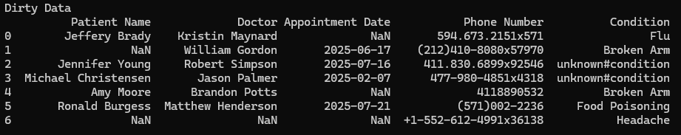
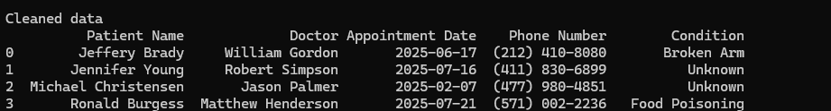
Data Cleaning & Normalization
Tidying Your Dataset
Removal of Unwanted Observations
Fixing Structure errors
Managing outliers
Handling Missing Data
Clean Data Supports
Accuracy and Quality
Consistency and Reliability
Stronger, More Insightful Analysis
Notes:
Reference: GeeksforGeeks. (2025, January 20). ML | Overview of Data Cleaning. GeeksforGeeks. https://www.geeksforgeeks.org/data-cleansing-introduction/
Data Generated From: OpenAI. (2025). ChatGPT [Large language model]. https://openai.com/chatgpt
When we talk about data handling, the first thing we want to focus on is cleaning and normalizing our data. When we first receive a dataset, it often shows up with inconsistencies, incorrect values, or missing information.
If we try to analyze data in that state, it can lead to bugs in our code, be hard to read, and produce inaccurate or just straight-up bad analytics results.
Take a look at our example here: we’ve got missing values, inconsistent formatting in the phone numbers and conditions, and some fields showing up as None.
To improve data quality, readability, and get more reliable analytics, we clean and normalize our data. That means removing duplicate values, dropping irrelevant data, transforming columns to be consistent, removing outliers that could skew our results, and fixing or filling in any missing data. When cleaning a dataset, we want to focus on four main steps:
Removal of Unwanted Observations: Removing duplicates or irrelevant data.
Fixing Structural Errors: Correcting inconsistencies in the data format.
Managing Outliers: Removing or transforming outliers.
Handling Missing Data: Removing records with missing values.

Slide 11
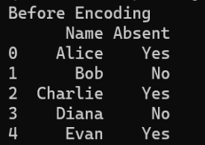
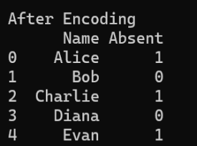
Feature Engineering
Feature Creation: Make new features from patterns or domain knowledge.
Feature Transformation: Normalize, scale, encode, or apply math to improve features.
Feature Extraction: Combine or transform existing features into new ones.
Feature Selection: Pick features that boost model performance.
Feature Scaling: Rescale features to similar ranges for better learning.
Notes:
Refernce: GeeksforGeeks. (2023, December 21). What is Feature Engineering? GeeksforGeeks. https://www.geeksforgeeks.org/what-is-feature-engineering/
Data Generated From: OpenAI. (2025). ChatGPT [Large language model]. https://openai.com/chatgpt
Feature engineering is the process of creating new features or transforming existing ones that aren't already in the dataset. This helps improve the accuracy and performance of a machine learning model by highlighting important patterns and relationships.
Before we get deeper, let's talk about what a feature actually is. A feature (also called a variable or attribute) is some property of a data point that can be measured and used as input for a machine learning algorithm.
Feature engineering usually involves five steps:
Feature Creation: Building new features based on patterns and domain knowledge.
Feature Transformation: Changing features to make them more useful for the model, like through normalization, scaling, encoding, or mathematical transformations.
Feature Extraction: Creating new features by transforming, combining, or aggregating existing ones.
Feature Selection: Picking a subset of features to improve the model’s performance. This can be done using a filter method (choosing features with high correlation) or a wrapper method (selecting features that actually improve the model's performance).
Feature Scaling: Adjusting features so they’re on a similar scale, which helps the model learn better. This can include min-max scaling, standard scaling, or robust scaling.
Lets look at an example, we have a table of students and weather or not they are absent, instead of using 'yes' or 'no' we can use Feature Transformation to encode this feature to 1 and 0s, this simplifying the feature for a model and saves space. In this case we will be using pandas .replace to replace the values in the Absent columns.
Speaker Notes:
“Once the data was clean, we created features that carried meaning beyond raw coordinates.
We began with feature creation—adding things like joint distances, angles, and direction vectors based on domain knowledge from motion studies.
We then applied transformation techniques like normalization and encoding to keep the values consistent and comparable across samples.
With extraction, we generated composite features by combining related joints—like left arm extension or body symmetry.
Selection helped us reduce noise. We dropped redundant or non-informative features so our models would train faster and interpret more clearly.
And finally, scaling ensured that features like X/Y position and distance operated on the same range—improving stability in downstream ML.”
Lets look at an example, we have a table of students and weather or not they are absent, instead of using 'yes' or 'no’ words we can use Feature Transformation to encode 1 and 0s. This simplifies the feature for a model and it saves space. Pandas .replace() method is used to transform the Absent column values.

Slide 12
Cleaning & Feature Engineering
Method | Description
.astype | converts a columns datatype
.replace | Replaces values
.apply | Applies a function to values
.dropna() | Removes rows with Null Values
.drop | Drops specific columns or rows
.is_unique | Returns true if the value is unique
.drop_duplicates | Remove dupicate rows
df[df[' column'] condition] | Filters values, masking
.dropna() | Removes rows with Null Values
Notes:
pandas documentation — pandas 2.2.3 documentation. (n.d.). https://pandas.pydata.org/docs/
Pandas provides a number of helpful tools and methods for data cleaning and feature engineering. Here are a few key ones:
.astype – Converts a column’s data type to another type
.replace – Replaces one or more values with another
.apply – Applies a function to each value, column, or row
.dropna – Removes rows with missing (NaN) values
.drop – Removes one or more specified columns
.is_unique – Returns True if all values in a column are unique
.drop_duplicates – Removes duplicate rows from the DataFrame
To filter values using masking, we access a DataFrame using bracket notation and pass a condition that returns a Series of boolean values (True or False for each row).

Slide 13
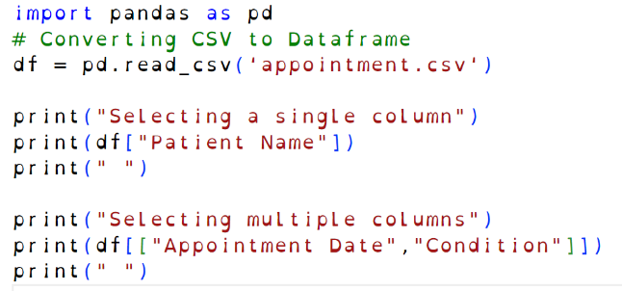
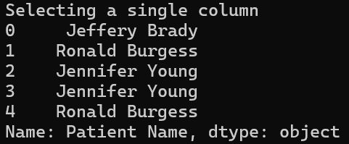
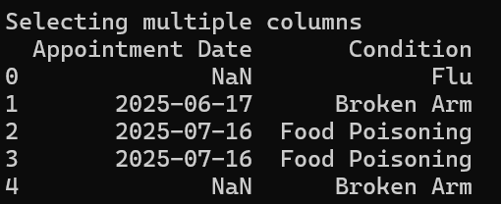
Indexing & Selecting Data
Syntax | Definition
df[column] | Selecting a single column
df[ [col1, col2] ] | Selecting multiple columns
.set_index | Replaces index with value or another column’s
.reset_index | Replaces index values with original values
.index | Returns the df index values
.column | Returns the column names
Notes:
Refernce: GeeksforGeeks. Indexing and selecting data — pandas 2.2.3 documentation. (n.d.). https://pandas.pydata.org/docs/user_guide/indexing.html
GeeksforGeeks. (2024, December 4). Indexing and Selecting Data with Pandas. GeeksforGeeks. https://www.geeksforgeeks.org/indexing-and-selecting-data-with-pandas/
Data Generated From: OpenAI. (2025). ChatGPT [Large language model]. https://openai.com/chatgpt
In order to work with data or call any of the methods seen in our last slide, we need to select specific rows and columns from DataFrames abbreviated as df.
Bracket notation, or the indexing operator, is the most common and one of the easiest ways to select content. Let’s look at examples:
df with [“Name"] selects a single column.
df with [[“Appointment Date", “Condition"]] selects multiple columns, nested in square brackets
In the example provided we can see both of these at work!
It's important to note that when we create a DataFrame, it has default indexes for its rows starting at 0. These indexes can be changed and manipulated, making selection and access a bit easier.
.set_index – A handy method that lets us replace our DataFrame’s index with the values from another column or columns
.reset_index – If you’re ever unhappy with your new index values, reset them.
I want to give a special mention to two helpful attributes that can be handy if you forget your index values or column names:
.index – Returns the index values: the original numbers or whatever you replaced them with using set_index.
.columns – Returns the names of all your columns.

Slide 14
Slicing
Syntax | Definition
df.loc[row] | Selecting row
df.loc[start:end] | A range of rows
df.loc[[row, column]] | Selecting multiple rows
df.loc[[row], [ col1, col2]] | Selecting specific rows and columns
df.loc[:, [col1,col2]] | Selecting all rows or columns with :
df.iloc[i] | Selecting row & columns by index
df.head(x) | Returns x top row
df.tail(x) | returns x bottom rows
Notes:
Refernce: GeeksforGeeks. Indexing and selecting data — pandas 2.2.3 documentation. (n.d.). https://pandas.pydata.org/docs/user_guide/indexing.html
GeeksforGeeks. (2024, December 4). Indexing and Selecting Data with Pandas. GeeksforGeeks. https://www.geeksforgeeks.org/indexing-and-selecting-data-with-pandas/
Data Generated From: OpenAI. (2025). ChatGPT [Large language model]. https://openai.com/chatgpt
Selecting columns is helpful but we can also slice ranges or chunks of data from our Dataframes
.loc is used to select specific rows. Since our rows are indexed by numbers in our example, we can use something like df.loc[0] to grab the first row.
To select a range of rows we can use bracket notation and our starting and ending ponts for our range. df[start, end]
To select multiple rows, nest square brackets and pass a list of the row numbers you want.
.loc can also select both rows and columns. Inside a single pair of square brackets, pass two lists separated by a comma — the first for the rows, the second for the columns.
You can select all rows or columns by using a : in place of a list.
Other helpful methods include:
.iloc — selects rows and columns strictly by their index positions (not labels). This method has the same syntax as .loc for selecting elements
.head() — returns top rows of the DataFrame; you can pass a number to control how many.
.tail() — works like .head() but returns rows from the bottom.
You can find even more methods in the Pandas documentation.

Slide 15
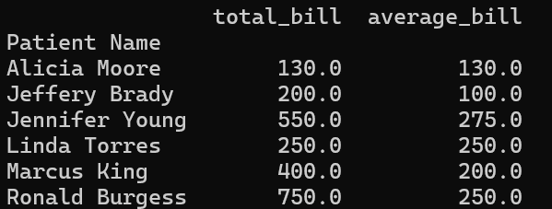
Group by Label
bill_info = df.groupby(‘Patient Name’).agg(total_bill=(‘Bill’, ‘sum’ ),average_bill(‘Bill’, ‘mean’))
print(bill_info)
Step | Description | Methods
Splitting | Grouping the data | .groupby()
Apply | Perform aggregation, transformation or filtering | .agg() - applies functions .transform() - mutates values .filter() - filters group on condition
Combing | Resulting DF | Happens automatically
Notes:
GeeksforGeeks. (2024a, December 3). Pandas dataframe.groupby() Method. GeeksforGeeks. https://www.geeksforgeeks.org/python-pandas-dataframe-groupby/#
Data Generated From: OpenAI. (2025). ChatGPT [Large language model]. https://openai.com/chatgpt
When we group by label, we are reorganizing our DataFrames into groups making way for better analysis.
The .groupby() method works in three steps:
Splitting — Grouping the data based on a column/s, index, values, etc.
Applying — Performing aggregation, transformation, or filtering on each group, and
Combining — Bringing the results back together into a new DataFrame.
In our example, we are splitting the data based on the "Patient Name" column using .groupby(). This method has a number of optional parameters for further customization. The .agg(), function takes an input that can include:
The new column name,
The original column to aggregate,
And the aggregation methods to apply.
In this case, we are using sum and mean, which results in a new DataFrame saved into bill_info.
In addition to .agg, .groupby() can also be used with transform, which mutates the DataFrame with specific operations, and filter, which filters out content based on a condition.

Slide 16
Integration & Visualization
Notes:
“Now that we’ve structured and transformed the data, let’s bring it to life with visualizations and numeric integration tools.”

Slide 17
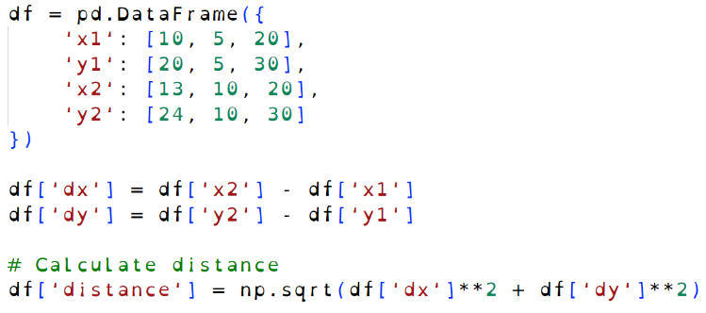

Pandas with NumPy
Method | Description
np.mean() | Mean of columns
np.median() | Median of columns
np.abs() | Absolute values
np.log() | Applies logarithm
np.exp() | Calculates exponent
np.round() | rounds values
np.sum() | sums values
df.to_numpy() | Dataframe to array
Notes:
GeeksforGeeks. (2024a, July 22). Difference between Pandas VS NumPy. GeeksforGeeks. https://www.geeksforgeeks.org/difference-between-pandas-vs-numpy/
IBM Technology. (2023, April 12). NumPy vs Pandas [Video]. YouTube. https://www.youtube.com/watch?v=KHoEbRH46Zk
Data Generated From: OpenAI. (2025). ChatGPT [Large language model]. https://openai.com/chatgpt
Pandas is a powerful tool for data analysis and manipulation, built on top of a library called NumPy, which specializes in numerical calculations, linear algebra, and working with multidimensional arrays. While Pandas excels at handling tabular data, NumPy is ideal for performing numerical operations.
In our example, we can use NumPy's .sqrt() function to calculate distances between points and add those values to our DataFrame as part of feature engineering.
Other helpful NumPy functions include:
np.mean() – calculates the mean of values
np.median() – calculates the median
np.abs() – returns absolute values
np.log() – applies logarithm
np.exp() – Calculates the exponential
np.round() – rounds values
np.sum() – sums values
If we need to convert our DataFrame to a NumPy array—for performance reasons or to use with other machine learning libraries—we can use df.to_numpy() to do so easily.
Speaker Notes:
“Pandas structured our pose data—but NumPy gave us the numerical muscle to extract more insight.
We used np.mean() and np.median() to smooth values over time, especially in cases where joint coordinates fluctuated unexpectedly between frames.
np.abs() was useful for isolating magnitude regardless of direction—helpful in tracking net joint movement.
np.log() and np.exp() may seem more mathematical than motion-specific, but they were useful in data normalization and, in future phases, they’ll support activation scaling or confidence modeling—especially when we're working with probability-weighted pose data.
np.round() helped with visual clarity when we needed to compress decimals, and np.sum() gave us joint travel totals across multi-frame segments.
Finally, that bottom line—df.to_numpy()—was our bridge between Pandas and NumPy. It let us pass our clean DataFrame directly into NumPy arrays for efficient computation, like calculating distance between shoulders or step length across a frame window.
Together, Pandas and NumPy let us manage both the structure and the math in our pose pipeline—without redundancy.”
In our example, we can use NumPy's .sqrt() function to calculate distances between points and add those values to our DataFrame as part of feature engineering.

Slide 18
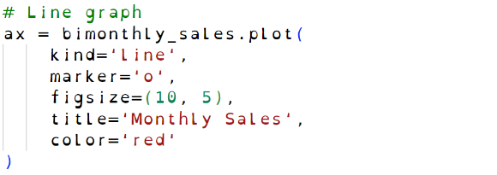
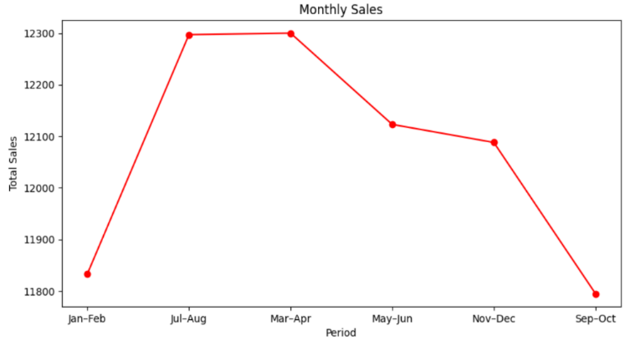

Visualization Techniques
Method | Description
.plot() | Create a plot object
.xlabel()/ylabel() | Sets axis labels
.xticks()/yticks() | Sets tick markers
.show() | Shows the plot window
.legend() | Adds legend to plot
Notes:
W3Schools.com. (n.d.-d). https://www.w3schools.com/python/matplotlib_plotting.asp
GeeksforGeeks. (2025a, January 17). Data Visualization with Pandas. GeeksforGeeks. https://www.geeksforgeeks.org/pandas-built-in-data-visualization-ml/
Data visualization allows us to transform raw data into a visual format, making it easier to spot trends, patterns, and correlations.
While we’ve seen how Pandas can clean and organize data, it can also create highly customizable visualizations including histograms, box plots, and scatter plots with the help of a library called Matplotlib.
In this example, we’ve extracted bi-monthly sales data from a DataFrame into a variable called bimonthly_sales. Using .plot() returns an object representing the chart. We’re customizing it by setting attributes like kind, marker, figsize (which sets the frame size), title, and color. We’re also using methods to set the y-axis label to "Total Sales" and to define the tick marks on the x-axis based on the number of data points we have.
Other helpful methods include, .show which will display the diagram and .legend to explain the symbols.

Slide 19
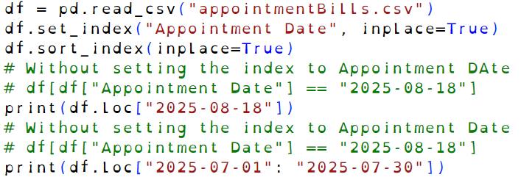
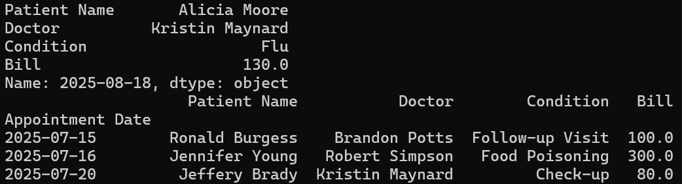
Time Series Slicing
Syntax | Description
df.loc[date] | Slicing a specific date
df.loc[date1:date2] | Slicing a date range
Notes:
Reference:How to handle time series data with ease — pandas 2.2.3 documentation. (n.d.). https://pandas.pydata.org/docs/getting_started/intro_tutorials/09_timeseries.html
GeeksforGeeks. (2025a, January 17). Data Visualization with Pandas. GeeksforGeeks. https://www.geeksforgeeks.org/pandas-built-in-data-visualization-ml/
Let’s say we’re working with data that includes time values or timestamps. We can use Pandas slicing to select specific date ranges from that data.
While it’s not strictly necessary, setting our date column as the DataFrame’s index using .set_index() makes date slicing much easier and more intuitive.
df.loc[date]: Just like slicing by a regular index, this allows us to select rows for a specific date.
df.loc[date1:date2]: We can also slice across a date range using the same syntax we’d use for slicing rows.
Speaker Notes:
“Let’s say we’re working with data that includes timestamps—like frame times or pose recording dates.
With Pandas, we can slice by date the same way we slice by row—but it works best if we first set our date column as the DataFrame index using .set_index(). This step isn’t strictly required, but it makes date-based slicing much cleaner and more intuitive.
Once that’s done, df.loc[date] lets us select a specific date—just like selecting a specific row.
If we want to compare across a time window, df.loc[start:end] slices across that date range using the same syntax we’d use for row slicing.
This technique was especially helpful when isolating movement sequences in our dataset. It allowed us to segment transitions—like a dancer stepping into a spin—based on when those frames occurred in time.”

Slide 20
Tutorial
Notes:
“This section sets up the hands-on Jupyter Notebook where you’ll apply each concept step by step.”

Slide 21
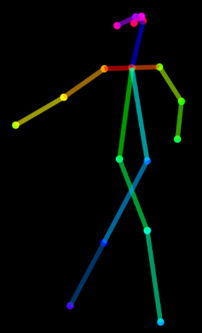
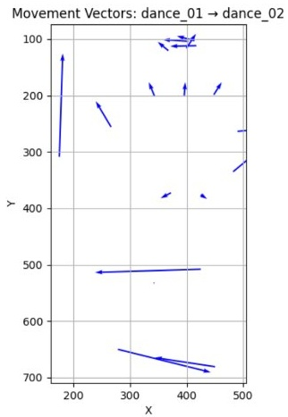
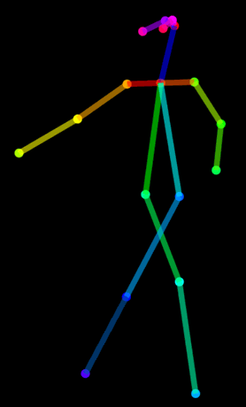
Objective
Notes:
In our tutorial, we’ll use the techniques and tools reviewed in this PowerPoint to diagram the movement from one pose to another using keyframes.
As mentioned earlier our eventual goal would be to use this data to track and analyze dance movements, train an AI model to recognize and dance moves.
While this process is simplified for the purpose of our demo, more advanced tools could be used in the future for greater accuracy such as optical flow for motion tracking in video and pose interpolation to interpret missing information between poses.

Slide 22
Summary of Workflow
Load and Examine Pose Data
Convert To DataFrames
Clean Data
Create Derived Features
Create Diagram
Notes:
In the upcoming tutorial, we’ll begin by loading and reviewing our pose data to get a sense of its structure and quality. Then, we’ll convert that data into Pandas DataFrames to make it easier to work with. After cleaning the data to remove any inconsistencies or missing values, we’ll generate new features—specifically, movement vectors that represent the direction and distance between poses. Finally, we’ll use Matplotlib to create diagrams that visualize these transitions, bringing the motion to life.

Slide 23
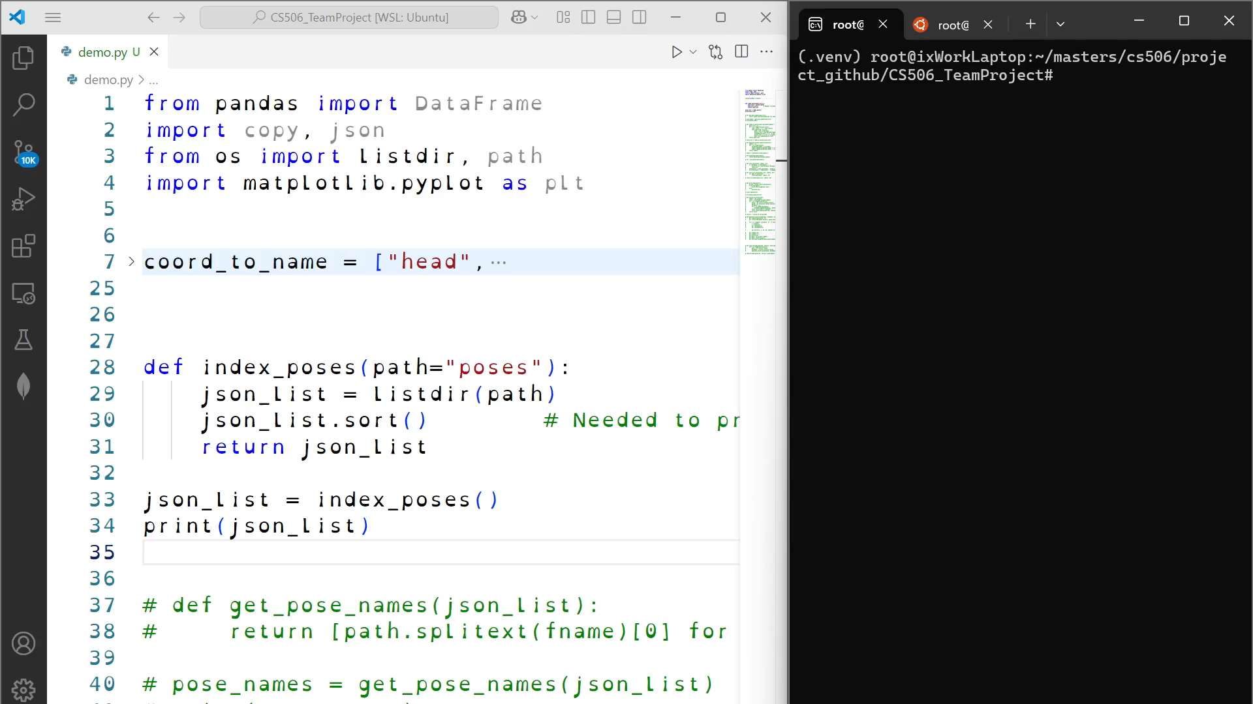
Demo
Notes:
~~TM
Speech

Slide 24
Applications
Games with Movement Input
Dance Games (e.g., Let's Dance)
Fitness Games (e.g., Shape Up)
Automated Choreography Recording
Dance
Fights/Stunts
Theatrical & Film Blocking
Choreography Instruction
Robotics
Physical Therapy
Athletic Analytics
Notes:
~~TM
“Let’s talk about where this pose-tracking data can actually make waves. First, think about games that use your body as the controller—dance games like Let’s Dance, or fitness games like Shape Up. But we can go further. We’re talking about automating choreography for fights, dances, or theater blocking—where precise movement capture is critical. Instructional choreography? Covered. Robotics path tracking? Possible. Even physical therapy and athletic analytics can use this kind of data to personalize recovery or optimize performance. It’s not just about movement—it’s about meaningful motion.”

Slide 25




Thank you!
Ixius Procopios
MS in CS
Verónica Elze
MS of AI
Hiromi Cota
MS of AI
Notes:
~~TM
“Thanks for watching us move through this topic—literally! We hope this presentation helped you understand not only what Pandas can do, but how it supports dynamic, real-world applications from games to gait analysis. Whether you're wrangling DataFrames or fine-tuning robot rhythm, we appreciate your time. And remember: in our team, even the data knows how to dance.”

Slide 26
References
GeeksforGeeks. (2025, January 20). ML | Overview of Data Cleaning. https://www.geeksforgeeks.org/data-cleansing-introduction/
GeeksforGeeks. (2023, December 21). What is Feature Engineering? https://www.geeksforgeeks.org/what-is-feature-engineering/
GeeksforGeeks. (2024, December 4). Indexing and Selecting Data with Pandas. https://www.geeksforgeeks.org/indexing-and-selecting-data-with-pandas/
GeeksforGeeks. (2024a, December 3). Pandas dataframe.groupby() Method. https://www.geeksforgeeks.org/python-pandas-dataframe-groupby/#
GeeksforGeeks. (2024a, July 22). Difference between Pandas VS NumPy. https://www.geeksforgeeks.org/difference-between-pandas-vs-numpy/
GeeksforGeeks. (2025a, January 17). Data Visualization with Pandas. https://www.geeksforgeeks.org/pandas-built-in-data-visualization-ml/
IBM Technology. (2023, April 12). NumPy vs Pandas [Video]. https://www.youtube.com/watch?v=KHoEbRH46Zk
W3Schools. (n.d.). Matplotlib Plotting. https://www.w3schools.com/python/matplotlib_plotting.asp
pandas documentation. (n.d.). Indexing and selecting data — pandas 2.2.3 documentation. https://pandas.pydata.org/docs/user_guide/indexing.html
pandas documentation. (n.d.). How to handle time series data with ease — pandas 2.2.3 documentation. https://pandas.pydata.org/docs/getting_started/intro_tutorials/09_timeseries.html
pandas documentation. (n.d.). Home — pandas 2.2.3 documentation. https://pandas.pydata.org/docs/
Notes:
~~TM
“To wrap up, these are the resources that supported our tutorial and findings—from Pandas documentation to GeeksforGeeks and IBM. We encourage you to explore these on your own, especially if you're curious about data selection methods or integrating Pandas with visualization libraries like Matplotlib. All references are APA formatted and clickable in the digital version.”
Module 1 (04/07–04/13):
Introduction to Python Pt. 1 📘 Textbook: Matthes (2023), Python Crash Course, Ch. 1–7 Topics Covered:
Getting started with Python
Variables and simple data types
Lists and if statements
Dictionaries
User inputs and while loops
Module 2 (04/14–04/20):
Introduction to Python Pt. 2 📘 Textbook: Matthes (2023), Ch. 8–10 📘 Supplement: Amos (2020), RealPython.com OOP PDF Topics Covered:
Functions and object-oriented programming
Classes and file handling
Exceptions
Module 3 (04/21–04/27):
Web Scraping & Working with Spreadsheets 📘 Textbook: Sweigart (2020), Automate the Boring Stuff Topics Covered:
Web scraping (Ch. 12)
Excel spreadsheet manipulation (Ch. 13)
Module 4 (04/28–05/04):
Data Visualization 📘 Textbook: Matthes (2023), Ch. 15 Topics Covered:
Generating and visualizing data using Python
Preparing Pandas visuals for team project TP01
✅ Team Project Submission #1 Due during this week

