Slide 1

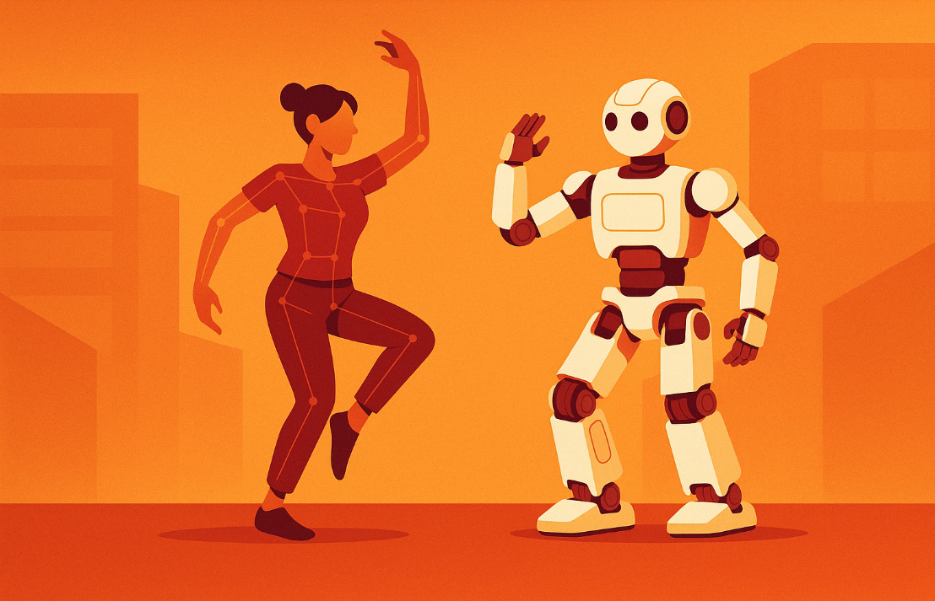



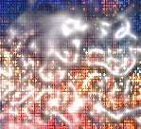


Dance Moves Detector
with Scikit-learn
School of Technology & Computing
Masters of Artificial Intelligence
Master of Computer Science
Verónica Elze
Hiromi Cota
Ixius
Procopios
Notes:
“Hi everyone, and welcome to our presentation: Dance Moves Detector with Scikit-learn. I’m Ixius Procopios, and along with Hiromi Cota and Verónica Elze, we are masters of computer science and artificial intelligence.
We built a pose-based motion classifier using Scikit-learn and OpenPose data. Today we’ll take you from raw JSON keypoints to motion vector classification and show how we turned it into a learning experience.”
Presentation Requirements 20-25 slides of “Introduction to Scikit-learn and its applications”. Topics including but not limited (1) Overview, (2) Basic features, (3) Supervised learning (2 types of your choice (e.g. linear models, super vector machines)), (3) Unsupervised learning (2 types of your choice (e.g. Gaussian mixture models, clustering)), (4) Model selection and evaluation, (5) Visualization techniques. [20 points]

Slide 2
Agenda
Introduction
Core Scikit Learning
Supervised Learning
Unsupervised Learning
Model Selection
Visualization Techniques
Notes:
“Here’s the flow: we’ll start by introducing our use case, review Scikit-learn’s core tools, then explore supervised and unsupervised learning. We’ll walk through how we selected our models, visualized data, and finish with a tutorial recap, a live demo, and potential applications.”

Slide 3
Overview and Use Case
Classify dance poses using pose-to-pose movement vectors
JSON input from OpenPose keypoints
Labeling based on filename prefixes
Target models: KNN and SVC for classification
Notes:
Slide 3: Overview and Use Case (⏱️ 0:45–1:41)
“We focused on classifying short dance poses using OpenPose keypoint data. Each pose was stored in a .json file with 2D joint coordinates. Instead of using raw coordinates directly, we calculated movement vectors between poses and used those as input features. Our aim was to train models like KNN and SVC to recognize patterns in motion—even with limited data.”
"Labeled dataset architecture and Scikit-learn starter by Hiromi formed the foundation of our classification pipeline."

Slide 4
Scikit Learning
Notes:
“Scikit-learn was our main tool. It gave us everything from preprocessing to modeling and evaluation—all with consistent, modular syntax. We used it to scale features, encode labels, split datasets, train models, and visualize performance.”

Slide 5

Fitting and Predicting
Train models using .fit(X_train, y_train)
Make predictions using .predict(X_test)
Output classification reports and confusion matrices
Notes:
“Once our data is ready, we move on to two core methods in Scikit-learn: .fit() and .predict(). .fit() is where the model learns patterns from the training data—basically, it figures out how your input features relate to the labels. Then .predict() is used to generate predictions on new, unseen data. That prediction output becomes the input for Scikit-learn’s evaluation tools—like classification_report() and confusion_matrix()—which help us measure how well the model is performing. This fit/predict pattern is the foundation of most Scikit-learn workflows.”

Slide 6
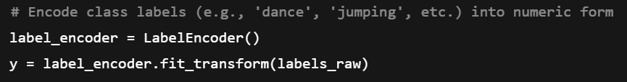

Transformers & Pre-Processors
Scaled motion vectors with StandardScaler()
Encoded class labels with LabelEncoder()
Scaling essential for KNN (distance-based logic)
Notes:
“Transformers in Scikit-learn are tools that modify your data in a meaningful way before modeling. We used StandardScaler() to normalize our features so that all joints and limb movements are on the same scale. That’s especially important for KNN, which compares distances between points. We also used LabelEncoder() to turn our string-based class labels—like 'dance' or 'jumping'—into numbers, so models could use them.”

Slide 7
Chaining
Scikit-learn supports chaining via Pipeline
Separated steps for clarity and debugging
Full implementation: bundle preprocessing and classification
Notes:
“Scikit-learn lets us chain steps using a Pipeline. That means we can bundle preprocessing steps like scaling, along with the model, into one object. This is great for keeping your code clean and ensures consistent processing during training and testing. In this project, we didn’t fully use pipelines—because we wanted to keep things transparent for debugging—but we recommend them for real-world workflows.”

Slide 8
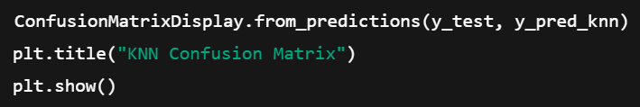
Model Evaluation
Metrics: Accuracy, precision, recall, F1-score
Used classification_report() and confusion_matrix()
Helped visualize where models succeeded or failed
Notes:
“After a model predicts, we need to know how well it did. Scikit-learn offers several evaluation metrics—accuracy, precision, recall, and F1-score. We used classification_report() for numeric summaries and confusion_matrix() to visualize class-by-class performance. This helped us quickly spot which classes were misclassified or ignored entirely.”

Slide 9

Automatic Parameter Searches
Exist: GridSearchCV, RandomizedSearchCV
Used manual tuning: n_neighbors, class_weight
Future work: Try full hyperparameter grid
Notes:
“Tuning a model’s parameters can make a big difference in performance. Scikit-learn includes tools like GridSearchCV and RandomizedSearchCV to automatically search for the best combination of parameters. In our project, we manually adjusted values like n_neighbors for KNN and class_weight for SVC. But in future work, we’d automate this process using a full parameter grid to explore more options efficiently.”

Slide 10
Supervised Learning
Notes:
“Let’s look at the supervised learning models we used: KNN and SVC. We used motion vector features to train both and compare their strengths.
Before training, we augmented our dataset to balance underrepresented classes using mirrored and jittered poses.”

Slide 11
K-Nearest Neighbors (KNN)
Non-parametric, distance-based classifier
Makes predictions by voting among the nearest labeled samples in training set
Sensitive to feature scaling & class imbalance
Notes:
“Let’s start with KNN—K-Nearest Neighbors. KNN is a very intuitive algorithm: it classifies new data points based on the labels of the closest neighbors in the training set. It doesn’t try to build a global model—instead, it stores all the training data and uses it at prediction time. This makes it a non-parametric, instance-based learner. It works well for simple problems but can be sensitive to how features are scaled and whether the class distribution is balanced.”
Helpful Resources for later
Ibm. (2025, April 17). What is the K-Nearest Neighbors (KNN) algorithm? Think. Retrieved May 16, 2025, from https://www.ibm.com/think/topics/knn#:~:text=The%20k%2Dnearest%20neighbors%20(KNN)%20algorithm%20is%20a%20non,used%20in%20machine%20learning%20today.
GeeksforGeeks. (2025, May 14). KNeArest Neighbor(KNN) algorithm. GeeksforGeeks. https://www.geeksforgeeks.org/k-nearest-neighbours/
💡 Slide Content (Concept Only)
KNN is a non-parametric, distance-based classifier.
Makes predictions by voting among the nearest labeled samples in the training set.
Sensitive to feature scaling and class imbalance.
🔍 Visual
A simple 2D diagram of a query point surrounded by neighbors of different colors (can be clip art or a quick sketch).

Slide 12
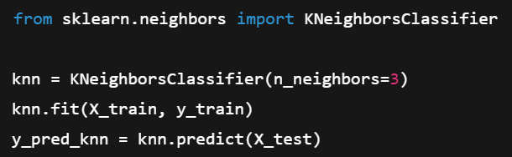
KNN Implementation
Notes:
“Here’s how we implemented KNN in Scikit-learn. We used KNeighborsClassifier with n_neighbors=3, trained it using .fit(), and predicted with .predict(). Since KNN relies on distance calculations, we scaled our input features using StandardScaler to make comparisons fair. Later, we evaluated predictions using a classification report and confusion matrix.”
KNeighborsClassifier. (n.d.). Scikit-learn. https://scikit-learn.org/stable/modules/generated/sklearn.neighbors.KNeighborsClassifier.html
GeeksforGeeks. (2025a, April 21). Implementation of KNN classifier using Scikit learn Python. GeeksforGeeks. https://www.geeksforgeeks.org/ml-implementation-of-knn-classifier-using-sklearn/
Features were scaled using StandardScaler()
Used train_test_split() with stratified labels
Baseline model before applying augmentation or weighting

Slide 13
Support Vector Classifier (SVC)
Separates classes with a max-margin boundary
Works for both linear & non-linear classification
Uses support vectors (critical training samples) to define decision boundary
Kernel functions help separate data in higher-dimensional space
Notes:
“Now let’s talk about SVC—Support Vector Classifier. This model tries to find the best possible boundary between classes, one that maximizes the margin between them. It uses only the most important training samples—called support vectors—to define that decision boundary. SVC is flexible too: using kernel functions, it can handle both linearly and non-linearly separable data by mapping it into higher dimensions.”
Resources:
GeeksforGeeks. (2025a, January 27). Support Vector Machine (SVM) algorithm. GeeksforGeeks. https://www.geeksforgeeks.org/support-vector-machine-algorithm/
Ibm. (2025a, April 16). What are support vector machines (SVMs)? Think. Retrieved May 16, 2025, from https://www.ibm.com/think/topics/support-vector-machine#:~:text=What%20are%20SVMs%3F,in%20an%20N%2Ddimensional%20space.
SVC is the classification implementation of the Support Vector Machine (SVM) algorithm in Scikit-learn
SVC is powerful for structured data. It tries to separate classes as cleanly as possible while maximizing the margin between them. The kernel trick lets it handle non-linearly separable problems.
Concept
- Explain what SVC is: "tries to find the optimal hyperplane separating classes" - Mention class_weight='balanced' for fairness - Discuss kernel trick briefly

Slide 14
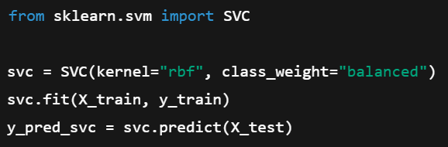
SVC Implementation
Notes:
“In our project, we used an rbf kernel, which works well for non-linear boundaries. We also added class_weight='balanced' to help with our imbalanced dataset, where some poses were much more common than others. Just like with KNN, we trained using .fit() and predicted with .predict().
We then compared results using the same evaluation tools—like confusion matrices and F1 scores.”
1.4. Support vector machines. (n.d.). Scikit-learn. https://scikit-learn.org/stable/modules/svm.html
GeeksforGeeks. (2025c, April 28). Implementing SVM and Kernel SVM with Python’s ScikitLearn. GeeksforGeeks. https://www.geeksforgeeks.org/implementing-svm-and-kernel-svm-with-pythons-scikit-learn/
NOTES:
We used the rbf kernel and applied class_weight='balanced' to help offset class imbalance. This version of SVC attempted predictions across more labels than KNN, but still struggled due to overlapping feature clusters.
SVC gave us more control over class weighting and separation boundaries, but still faced challenges due to limited data diversity and overlapping clusters.
Uses kernels (we chose "rbf") for nonlinear separation
Applied class_weight='balanced' to handle class imbalance
SVC offers more control over margin and class weighting, but still struggled with overlap

Slide 15
Unsupervised Learning
Notes:
“Unsupervised learning means we’re working with unlabeled data—no ground truth.”
📌 Goal: Introduce the idea of unsupervised learning.
Content:
Definition: Learning from unlabeled data
Why we included it in this project:
"We used clustering to understand natural groupings in our motion vectors—before labels were introduced."
Visual: Include a small PCA scatterplot showing all classes (colored by label) 🛰️ From your PCA plot in Step 5

Slide 16
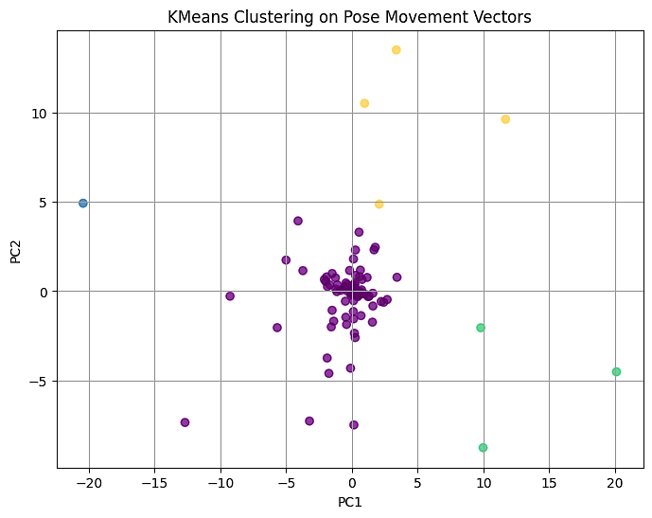
Clustering
Notes:
“One of the most common unsupervised learning techniques is clustering. Clustering groups data points that are similar to each other. Here, we applied KMeans to our motion vector features. Each point in this PCA plot represents a pose, and each color is a different cluster. This let us explore whether poses naturally separate into meaningful groupings—even without labels.”
GeeksforGeeks. (2025a, January 27). Clustering in machine learning. GeeksforGeeks. https://www.geeksforgeeks.org/clustering-in-machine-learning/
What is clustering? (n.d.). Google for Developers. https://developers.google.com/machine-learning/clustering/overview#:~:text=Clustering%20is%20an%20unsupervised%20machine,evaluate%20a%20new%20treatment%20protocol.
📌 Goal: Focus on KMeans
Content:
Quick description of KMeans
Parameters used (e.g., n_clusters=4)
Outcome: did the clusters align with known labels?
Visual:
PCA plot with c=clusters colored by KMeans
Use viridis colormap
✅ Title:
KMeans Clustering on PCA-Reduced Pose Vectors
🖼️ Description:
This plot shows pose movement features reduced to two dimensions with PCA, then clustered into 4 groups using KMeans. Colors represent different cluster assignments using the viridis colormap.
This is a great visual anchor to:
Show how unsupervised learning organizes unlabeled data
Compare structure between real classes and algorithm-discovered clusters

Slide 17
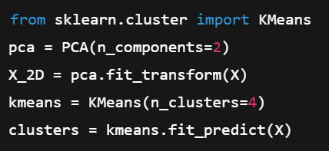
Clustering Implementation
Notes:
“To cluster our pose vectors, we first reduced the feature space using PCA. That gave us a 2D view of high-dimensional pose data. Then we used Scikit-learn’s KMeans algorithm with 4 clusters. This assigns each pose to a group based on its similarity to the cluster center. This code block shows how simple it is to chain PCA and KMeans with Scikit-learn.”
2.3. Clustering. (n.d.). Scikit-learn. https://scikit-learn.org/stable/modules/clustering.html
GeeksforGeeks. (2024, June 12). Hierarchical Clustering with ScikitLearn. GeeksforGeeks. https://www.geeksforgeeks.org/hierarchical-clustering-with-scikit-learn/
📌 Goal: Show how we implemented it
Content (left column):
from sklearn.cluster import KMeans pca = PCA(n_components=2) X_2D = pca.fit_transform(X) kmeans = KMeans(n_clusters=4) clusters = kmeans.fit_predict(X)
Visual (right column):
Side-by-side: PCA before/after clustering (optional)
Or one plot with true labels vs predicted cluster colors

Slide 18
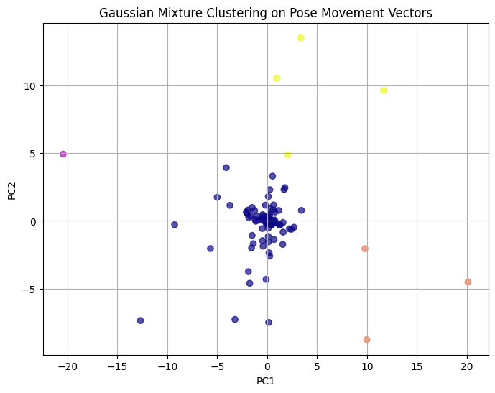
Gaussian Mixture Model (GMM)
Probabilistic clustering method
Models data as mixture of Gaussian distributions
Useful when clusters have different shapes or overlap
Notes:
“KMeans assigns each point to one cluster only. But what if a point might belong to more than one group? That’s where Gaussian Mixture Models—or GMM—come in. GMM is a probabilistic model that represents data as a mixture of overlapping distributions. It’s especially useful when clusters aren’t perfectly round or evenly spaced, like you see here.”
GeeksforGeeks. (2025c, February 27). Gaussian Mixture Model. GeeksforGeeks. https://www.geeksforgeeks.org/gaussian-mixture-model/
📌 Goal: Introduce GMMs
Content:
Description: Probabilistic clustering
Why it complements KMeans
How you used it to compare results
Visual:
PCA plot with GMM cluster coloring (plasma colormap)
NOTES:
“A Gaussian mixture model (GMM) is a machine learning method used to determine the probability each data point belongs to a given cluster. The model is a soft clustering method used in unsupervised learning.” https://builtin.com/articles/gaussian-mixture-model
Concept overview
GMM is a probabilistic clustering method Unlike KMeans, it models data as a mixture of Gaussian distributions Useful when clusters have different shapes or overlap

Slide 19
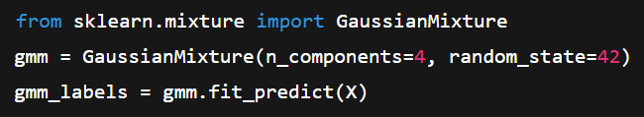
Gaussian Implementation
Notes:
“GMM is just as easy to implement in Scikit-learn. We define the number of components, fit the model, and get cluster labels. Unlike KMeans, these labels are based on likelihood: each pose gets assigned to the distribution it most likely belongs to. This is a great alternative when data is messy or overlaps.”
2.1. Gaussian mixture models. (n.d.). Scikit-learn. https://scikit-learn.org/stable/modules/mixture.html
GeeksforGeeks. (2025c, February 7). Gaussian Mixture Models (GMM) in SciKit Learn. GeeksforGeeks. https://www.geeksforgeeks.org/gaussian-mixture-models-gmm-covariances-in-scikit-learn/#
📌 Goal: Show GMM code and difference
Content (left):
from sklearn.mixture import GaussianMixture gmm = GaussianMixture(n_components=4) gmm_labels = gmm.fit_predict(X)
Visual (right):
PCA scatterplot with GMM clusters
Emphasize that boundaries are soft, not hard
Code and result
- Show your GaussianMixture(n_components=4) + fit_predict(X) - Include PCA plot colored by GMM cluster assignments (c=gmm_labels, cmap="plasma")

Slide 20
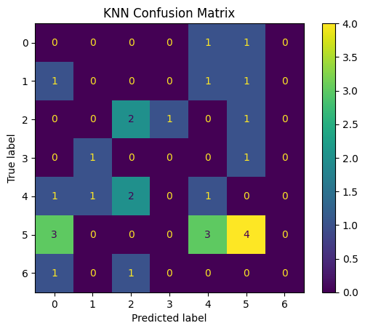
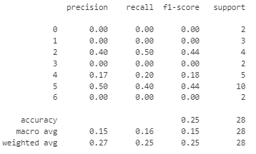
Model Selection & Evaluation
KNN Evaluation Metrics Report
Notes:
“Once we trained our models, we evaluated their predictions using Scikit-learn’s built-in tools. Here you see a confusion matrix, which compares predicted vs. actual labels. This one is from our KNN classifier. Dark squares along the diagonal mean correct predictions—lighter colors and off-diagonal cells show misclassifications. We also used a classification report to calculate accuracy, precision, recall, and F1 score. This helped us understand which poses were recognized well and which were missed.”
📌 Goal: Summarize results from KNN and SVC
Content:
KNN Accuracy: 25% (confusion matrix shown)
SVC Accuracy: 21% with class_weight='balanced'
What worked, what didn’t
Visual:
KNN confusion matrix (as in notebook)
Table comparing KNN and SVC F1-scores by class (optional)
KNN (Model 1) was evaluated on 7 classes. It achieved 25% overall accuracy, with low precision and recall for underrepresented classes.

Slide 21
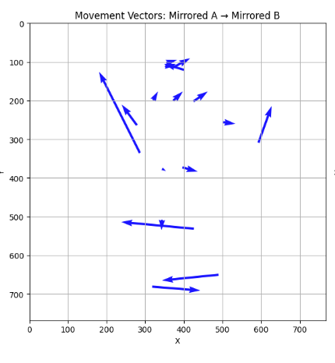
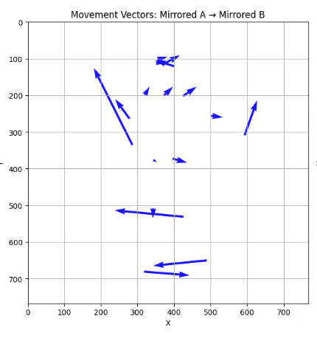
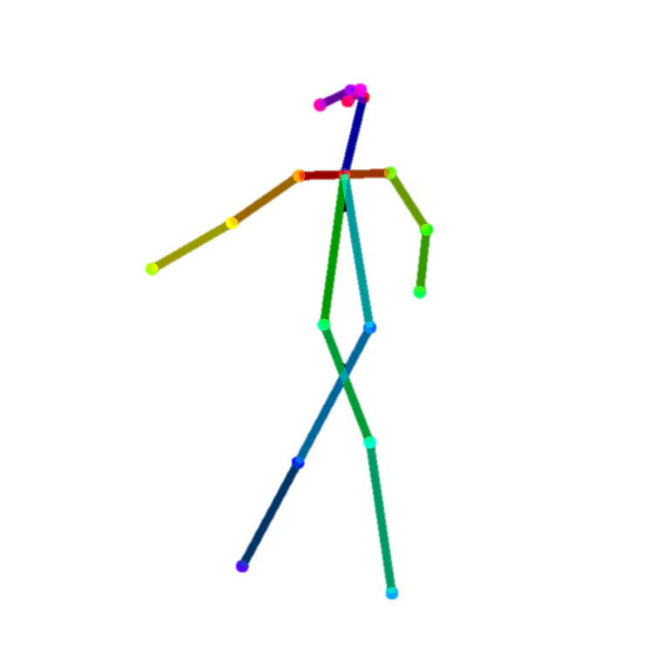
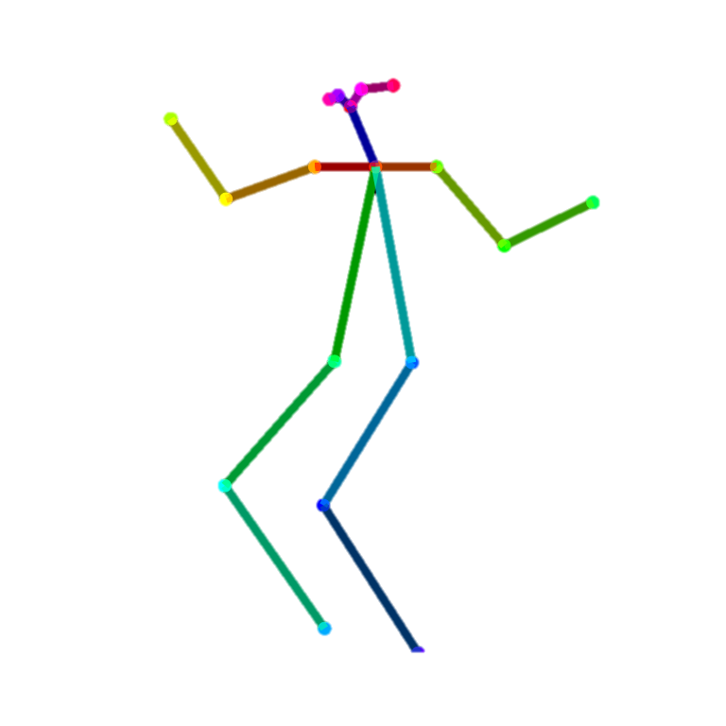
Visualization Techniques
y
y
Notes:
“Finally, we used visualization to understand both data and model behavior. These stick figure plots show movement transitions from one pose to another. We used arrows to show joint displacement—how a joint moved between two frames. The color-coded limbs come from OpenPose, and the motion arrows help confirm our augmentations are meaningful. These visuals were key to verifying that the models weren’t just memorizing static poses—but actually learning how bodies move.”
NOTES:
🛰️ PCA scatterplots
“We used PCA to reduce the dimensionality of our pose vectors, which let us visualize how well different movements separated in feature space. It gave us early insight into why certain classes might overlap or confuse the models.”
🌀 Quiver plots for pose transitions
“On the left and right, you see mirrored poses with arrows showing joint movement. These ‘quiver plots’ helped us verify that our augmentation strategy introduced meaningful variation while still maintaining body structure.”
🎯 Color-coded stick figures
“We also animated transitions between poses with rainbow-colored line segments to reinforce the continuity of motion.”
“Together, these visuals made the tutorial more accessible and helped us debug both data and model output.”
📌 Goal: Explain how visuals supported learning
Content:
PCA: feature separability
Quiver plots: movement between poses
Stick figure overlays: visual checks for augmentation
Visuals:
One quiver plot of pose movement
One side-by-side stick figure plots

Slide 22
Tutorial
on GitHub
Notes:
“Now that we’ve seen how the models and techniques work, let’s shift into the practical side—what our tutorial demonstrates and how it all comes together. We’ll walk through a demo and explore real-world applications for what we built.”
https://github.com/HiromiCota/CS506_TeamProject/tree/vero
📌 Goal: Directly connect to the notebook
Content:
Explain this is a guided tutorial for Scikit-learn
Mention it integrates:
Feature engineering
Supervised and unsupervised learning
Visual validation
Visual (Optional):
Screenshot of the notebook’s section headers or PCA markdown
# 🎓 Submission #2 - Tutorial: Dance Move Classification using Scikit-learn
## 📘 Intro / Overview
## 🧰 Imports and Setup
## 📂 Step 1: Load and Structure Pose Data
## 🧹 Step 2: Preprocessing: Cleaning, Scaling, and Encoding
## 🛠️ Step 3: Feature Engineering with Pose Vectors
## ✂️ Step 4: Train / Test Split
## 🛰️ Step 5: Visualize Feature Space
## 🤖 Step 6: Supervised Learning Models
## 🎨 Step 7: Visualize Pose Movement
## 🌐 Step 8: Unsupervised Learning: Clustering with KMeans and GMM
## 📊 Step 9: Evaluate Model Performance
## 🧪 Step 10: Add Model for Comparison (optional)
## 📘 What We Learned
## ✅ Conclusion & Next Steps
## 📚 References

Slide 23
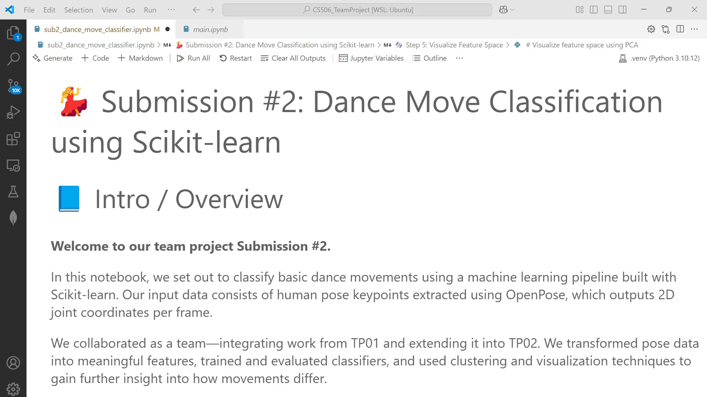
Demo
Notes:
“Dance Moves Classifier in Action” Time-coded, polished, and paced for ~90 seconds total runtime.
🎬 TP02 Demo Voiceover Script
⏱️ [0:00–0:10] Intro
“Welcome to our TP02 project demo: Dance Move Classification using Scikit-learn. We’re turning pose detection into pose recognition—step by step.”
⏱️ [0:11–0:20] Data Preprocessing
“We start by preparing the data. Missing values are dropped, features are scaled with StandardScaler, and class labels are encoded with LabelEncoder.”
⏱️ [0:21–0:35] Feature Visualization with PCA
“Next, we reduce the dimensionality of our pose vectors using PCA. Each point now represents a pose in 2D space—revealing patterns across classes before we even train.”
⏱️ [0:36–0:50] Model Training
“We train two supervised models: K-Nearest Neighbors and Support Vector Classifier. The SVC uses a balanced class weight to better handle imbalanced labels.”
⏱️ [0:51–1:05] Model Evaluation
“Here’s the result: KNN heavily favors class 5, while SVC distributes predictions more evenly. We evaluate with confusion matrices and classification reports.”
⏱️ [1:06–1:20] Clustering & Augmentation
“We also explore unsupervised learning. KMeans and GMM reveal natural groupings in our data, even without labels. Meanwhile, jittering and mirroring give our model a more diverse training set.”
⏱️ [1:21–1:30] Conclusion
“This pipeline takes us from raw pose data to intelligent motion classification. Next up: TP03—where we tackle sequence modeling using PyTorch.”
🧰 TOOLS YOU’LL NEED (substitute for your favorite tools as needed)
Microsft Steam & Clipchamp are Office 365 tools provided by CityU that are easy to use.
Voiceover Recording: Audacity (free) or GarageBand (Mac users)
Background Music: Royalty-free tracks from sites like Free Music Archive or Bensound
Optional: Stick-figure animations or dance clip overlays for transitions
🎤 Voiceover Script & Visuals Breakdown
[0:00–0:10] Title & Introduction
Visual: Animated title card: “TP02 Demo: Dance Move Classification with Scikit-learn”
Voiceover:
"Welcome to our TP02 project demo: Dance Move Classification using Scikit-learn."
[0:11–0:20] Data Preprocessing
Visual: Screen capture of notebook cells executing:
df.dropna()
StandardScaler()
LabelEncoder()
Overlay Text: “🧹 Data Cleaning & Encoding”
Voiceover:
"We begin by cleaning the dataset, scaling features, and encoding labels to prepare for model training."
[0:21–0:35] Feature Visualization with PCA
Visual: Display PCA scatter plot:
plt.scatter(X_2D[:, 0], X_2D[:, 1], c=y, cmap='tab10')
Overlay Text: “🎨 PCA Feature Space”
Voiceover:
"Applying PCA reduces our feature space to two dimensions, revealing distinct clusters for different dance moves."
[0:36–0:50] Model Training
Visual: Code snippets:
knn = KNeighborsClassifier(n_neighbors=3)
svc = SVC(kernel='rbf', class_weight='balanced')
Overlay Text: “🤖 Training KNN & SVC Models”
Voiceover:
"We train two models: K-Nearest Neighbors and Support Vector Classifier, with class balancing to handle data imbalance."
[0:51–1:05] Model Evaluation
Visual: Confusion matrices for both models
Overlay Text: “📊 Model Performance”
Voiceover:
"Evaluation shows KNN favors class 5, while SVC provides more balanced predictions across classes."
[1:06–1:20] Clustering & Data Augmentation
Visual: Display:
KMeans clustering PCA plot
GMM clustering PCA plot
Quiver plots showing data augmentation
Overlay Text: “🌀 Clustering & Augmentation”
Voiceover:
"Unsupervised clustering with KMeans and GMM reveals natural groupings. Data augmentation through jittering and mirroring enhances model robustness."
[1:21–1:30] Conclusion & Next Steps
Visual: Final PCA plot with overlays, credits slide
Overlay Text: “✅ TP02 Complete — Up Next: TP03 with PyTorch”
Voiceover:
"From preprocessing to classification, this pipeline sets the stage for TP03, where we'll delve into sequence modeling with PyTorch."
🎵 Background Music Suggestions
Choose a light, upbeat instrumental track that complements the pace of the demo without overpowering the voiceover. Ensure the music is royalty-free.
🎬 Part 1: Use Microsoft Stream to Record Your Demo
Stream is great for capturing your screen and voice at the same time.
🔧 How to Use Microsoft Stream
✅ Step-by-Step:
Open Stream via Office 365:
Go to https://stream.office.com and log in with your student credentials.
Click “+ New recording”
Select your screen (or specific window if showing notebook visuals)
Allow mic and camera (if you're including yourself on screen)
Record your voiceover while demonstrating:
Run cells in your Jupyter Notebook (HTML version works great for display)
Narrate the demo using the script provided earlier
Pause where needed—Stream lets you edit afterward
Click “Stop” and “Upload to Stream”
Title your video: “TP02 Demo: Dance Movement Classifier”
Select "Only people in your organization" if sharing internally
🎞️ Part 2: Use Clipchamp to Edit & Enhance
Clipchamp is Microsoft's built-in video editor—great for trimming, adding overlays, titles, music, and exporting in MP4.
🔧 How to Use Clipchamp
✅ Step-by-Step:
Launch Clipchamp
Go to https://clipchamp.com or search from Start menu
Log in using your Microsoft student account
Import your Stream video
Or upload any MP4 screen recordings
Drag it into the timeline
Add Title Card and Overlays
Use a title slide like: “TP02 Demo – Dance Move Classifier”
Add animated labels: “PCA”, “KNN Confusion Matrix”, etc.
Insert Your Animated Visuals
Add your:
Quiver GIF (dance_01_to_02_to_01_colored.gif)
PCA plot image
Stick figure transitions
Adjust timing with voice
Add Background Music
Go to “Music & SFX”
Choose a soft instrumental or lo-fi beat
Lower music volume under voiceover (~10–20%)
Export Your Video
Click “Export” > Choose 1080p
Save your final MP4 demo
TP02_Demo/
├── narration_script.docx
├── screen_recording.mp4 (from Stream)
├── quiver_plot.gif
├── midpoint_pose.png
├── pca_kmeans_plot.png
├── TP02_demo_final.mp4
📌 Goal: Tease or present a live example
Option A:
Show animation or screenshots of pose diagrams
Walk through one example from dance_01 to dance_01_jittered/mirrored/other
Option B:
Live scroll-through of final notebook cells
Emphasize results from model evaluation or vector diagrams

Slide 24
Applications
🎮 Gesture-based gaming
🕺 Dance learning or fitness feedback
🦾 Robotics imitation of human motion
Notes:
“Let’s look at where this kind of pose classification could go. First, in gesture-based gaming, we could use pose transitions to trigger in-game actions or commands. In education or fitness, our model could offer real-time feedback on dance accuracy or form. And in robotics, this data could help robots imitate human motion—either in rehab support or expressive robotics.”
🕹️ Gesture-based gaming
“We could use motion vector detection to trigger actions in a game—think of a player striking a pose to cast a spell or activate a skill.”
🕺 Dance learning or fitness feedback
“By classifying poses in real time, we can give users live feedback on form, repetition, or choreography—perfect for learning dance routines or tracking workout progress.”
🤖 Robotics imitation of human motion
“These pose transitions could train a robot to imitate human gestures, especially if we sequence multiple predictions into meaningful motion.”

Slide 25
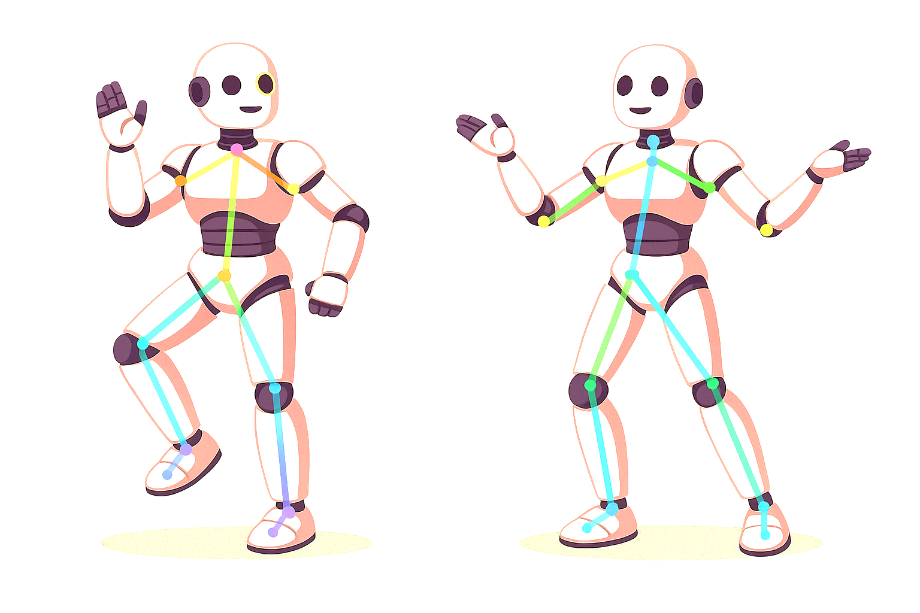


Thank you!
Ixius Procopios
MS in CS
Verónica Elze
MS of AI
Hiromi Cota
MS of AI
Notes:
“Thank you for exploring our dance pose classification project with us!”
“This work reflects a true collaboration—built from our loading and structure pipeline, extended through our vectorization and visualization tools, and polished into a full Scikit-learn tutorial.”
“Whether you're here for machine learning, motion analysis, or educational AI tools, Verónica, Ixius, and Hiromi hope this project inspires your own work—and gets you moving, both intellectually and physically!”

Slide 26
References
Matthes, E. (2023). *Python Crash Course* (3rd ed.). No Starch Press.
Microsoft. (2025). *Fundamentals of Generative AI*.https://learn.microsoft.com
OpenAI. (2025). *ChatGPT’s assistance with classification design* [Large language model]. https://openai.com/chatgpt
Scikit-learn. (n.d.). *User Guide*. https://scikit-learn.org/stable/user_guide.html
W3Schools. (n.d.). *StandardScaler and LabelEncoder*. https://www.w3schools.com/python/scikit_learn_intro.asp
Real Python. (n.d.). *Scikit-learn Tutorial*.
https://realpython.com/python-machine-learning/
Notes:
“Here are the core references we used throughout this project—from Scikit-learn’s own user guide to our textbooks and OpenAI support. We’ve also cited Microsoft’s generative AI module for guidance on responsible use.
You’ll find APA-formatted versions in our notebook and README.”
Module 1 (04/07–04/13):
Introduction to Python Pt. 1 📘 Textbook: Matthes (2023), Python Crash Course, Ch. 1–7 Topics Covered:
Getting started with Python
Variables and simple data types
Lists and if statements
Dictionaries
User inputs and while loops
Module 2 (04/14–04/20):
Introduction to Python Pt. 2 📘 Textbook: Matthes (2023), Ch. 8–10 📘 Supplement: Amos (2020), RealPython.com OOP PDF Topics Covered:
Functions and object-oriented programming
Classes and file handling
Exceptions
Module 3 (04/21–04/27):
Web Scraping & Working with Spreadsheets 📘 Textbook: Sweigart (2020), Automate the Boring Stuff Topics Covered:
Web scraping (Ch. 12)
Excel spreadsheet manipulation (Ch. 13)
Module 4 (04/28–05/04):
Data Visualization 📘 Textbook: Matthes (2023), Ch. 15 Topics Covered:
Generating and visualizing data using Python
Preparing Pandas visuals for team project TP01
✅ Team Project Submission #1 Due during this week

