Slide 1








Dance Moves Detector
with
PyTorch
School of Technology & Computing
Masters of Artificial Intelligence
Master of Computer Science
Verónica Elze
Hiromi Cota
Ixius
Procopios

Slide 2
Agenda
Introduction
Neural Networks
PyTorch Overview
Tensors
Datasets and Data Loading
Transformers
Building Neural Networks
Training Neural Networks with PyTorch
Optimization
Save, Load and Use Models

Slide 3
Overview and Use Case
Transition from static models to neural networks
Optimize data handling
Improved Training and Evolution
Enhanced visualization
Notes:
Pulled from the README.md Key improvements
Transitioned from static models (Random Forest, PCA, KNN) to neural networks: Flexible and powerful model architecture.
Optimized data handling: Leveraged PyTorch’s tensor operations and batching.
Improved training and evaluation: Integrated PyTorch’s automatic di·fr·en·chee·ay·shn for efficient training.
Enhanced visualization: Provided clear, distinct visual feedback throughout training.

Slide 4
Neural Networks
Notes:
PyTorch is a framework that allows us to build and Train Nural Networks so before we dive into PyTorch lets review Neural Networks!

Slide 5
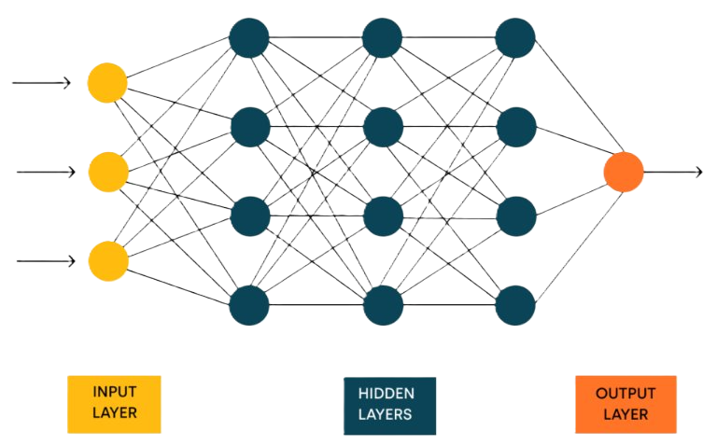
Neural Networks Overview
Network of Neurons
Receives Input as a Tensor
Learns Patterns in Hidden Layers
Produces Output as Probabilities
(Rojewska, 2024)
Notes:
Image citation: Rojewska, K. (2024, March 8). What are Neural Networks and What are Their Applications? Qtravel.ai. https://www.qtravel.ai/blog/what-are-neural-networks-and-what-are-their-applications/
Other citations: Daniel Bourke. (2022, July 24). Learn PyTorch for deep learning in a day. Literally. [Video]. YouTube. https://www.youtube.com/watch?v=Z_ikDlimN6A
Neural networks are made up of units called neurons, kind of like how neurons in the brain work, one neuron can activate others. The nurons are organized into layers for processing information.
When data (like text or images) is converted into numbers, through numerical encoding (as a tensor), it can be passed through the layers of a neural network. As the data moves through each layer, the network learns patterns in the data by detecting relationships and features.
By the time the data reaches the final layer, the network produces an output, usually in the form of percentages or probabilities that represent how likely it thinks the input matches certain categories or labels. Anatomy of Neural Networks
Input layer – where data is entered
Hidden layer – where the pattern is identified
Output layer – perditions and probablilities

Slide 6
PyTorch

Slide 7
Key Features
Open Source
Free
Pythonic
Models
Multi-GPU
CUDA
Fast
Affordable
Flexible
Deep Learning
OpenAI
Microsoft
Pre-processing
Model Building
Model Training
Cloud Deployment
End-to-End ML
Pre-built Models
High-performing
Rapid Prototyping
Community
Documentation
Tutorials
Collaboration
Notes:
Resources: https://www.nvidia.com/en-us/glossary/pytorch/
Citations: PyTorch. (2021, April 16). Introduction to PyTorch [Video]. YouTube. https://www.youtube.com/watch?v=IC0_FRiX-sw
Daniel Bourke. (2022b, July 24). Learn PyTorch for deep learning in a day. Literally. [Video]. YouTube. https://www.youtube.com/watch?v=Z_ikDlimN6A
PyTorch is a free, open-source Python framework for machine learning. It offers a wide range of tools for building and training models
Fast and flexible deep learning code
Multi-GPU acceleration
PyTorch leverages accelerators like CUDA that allows the use of Nvida GPUs to run machine learning code
This allowed ML to become more accessibility in terms of speed, affordability.
\Prebuilt deep learning models
Full support for end-to-end ML applications
Preprocess data
Build and train Models
Deployment
Originally developed by Meta, PyTorch is now open source and widely adopted by companies like OpenAI, Microsoft, and many others.
Tensor Computations
Dynamic Computation Graphs
GPU Acceleration
Flexible Neural Networks
Torch Script for Production
Large Community and Documentation

Slide 8
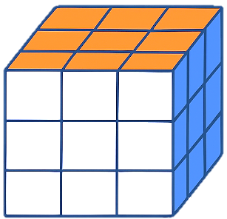
Tensors Introduction
[3, 3, 3]
Multi Dimensional Array
Numerical Encoded input
Representational Output
Over 100 helpful Methods
Manipulation
Transformation
Analysis…
Slicing
← Columns →
← Depth →
← Rows →
Notes:
Daniel Bourke. (2022b, July 24). Learn PyTorch for deep learning in a day. Literally. [Video]. YouTube. https://www.youtube.com/watch?v=Z_ikDlimN6A
Tensors are the core data structure in PyTorch — a type of multi-dimensional array used to represent numerical data.
They're used to input data into models and to hold representational outputs like predictions or embeddings.
PyTorch tensors come with 100+ built-in methods for:
Math operations
Reshaping and slicing
Gradient tracking
GPU acceleration
Data manipulation and transformation
Analysis and more!

Slide 9
Tensor Example
[[416.9700, 111.6800], [395.4900, 200.3200], [343.1900, 201.9700], [266.1200, 255.9300]]
[[0.762,
0.134,
0.104],
[0.219,
0.811,
0.024],
[0.045,
0.057,
0.898]]
Notes:
Here's how tensors are used in PyTorch: We take our input data, convert it into a numerical format (a tensor), pass it through a neural network, and get an output tensor that holds the results often something like class scores or predictions.

Slide 10
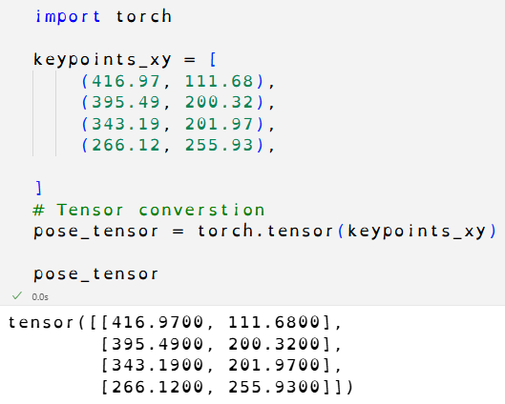
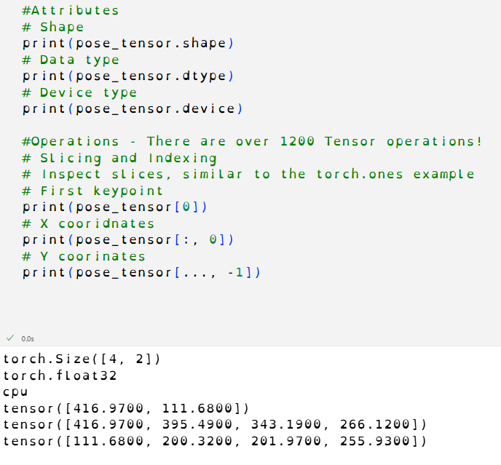
Tensor Example
Notes:
Citation: Tensors — PyTorch Tutorials 2.7.0+cu126 documentation. (n.d.). https://docs.pytorch.org/tutorials/beginner/basics/tensorqs_tutorial.html
Let’s take a look at some code!
In our first example, we’re converting keypoint (x, y) coordinates into a tensor. (Just a note: NumPy arrays can also be easily converted into tensors though that’s not shown here.)
In our second example, we explore tensor attributes, which include:
.shape – the dimensions of the tensor (like rows and columns)
.dtype – the data type of the elements (e.g., float32, int64)
.device – where the tensor is stored (in this case, it's on my laptop’s CPU)
There are over 1,200 tensor operations in PyTorch! These include:
Arithmetic
Indexing
Slicing and joining
Reshaping and manipulating
And many more
In this demo, we focus on indexing and slicing. We access:
The first keypoint with index 0
All x coordinates with [:, 0]
All y coordinates with [:, 1]
I encourage you to check out the PyTorch docs to see all the other powerful operations available!

Slide 11

Datasets & Data Loaders
torch.utils.data.Dataset
Store and access samples and labels
torch.utils.data.DataLoader
Wraps an iterable around Dataset
Notes:
Citation: Datasets & DataLoaders — PyTorch Tutorials 2.7.0+cu126 documentation. (n.d.). https://docs.pytorch.org/tutorials/beginner/basics/data_tutorial.html
To keep our code clean, readable, and maintainable, it’s important to separate our dataset logic from our model training code.
PyTorch provides two key data primitives for this:
Torch.utils.data.Dataset
Used to store and access samples and labels
You define how data is loaded and optionally transformed
Torch.utils.data.DataLoader
Wraps an iterable around your Dataset
Handles batching, shuffling, and parallel loading behind the scenes

Slide 12
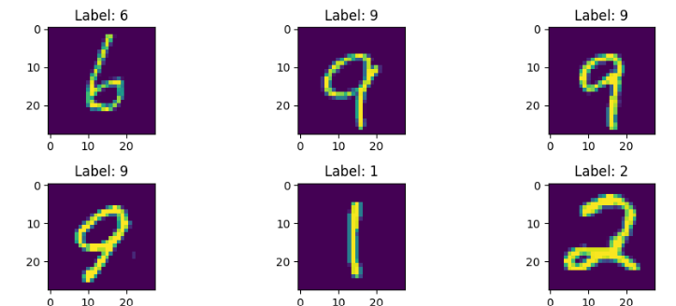
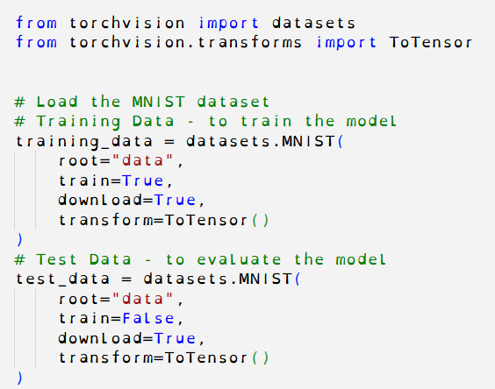
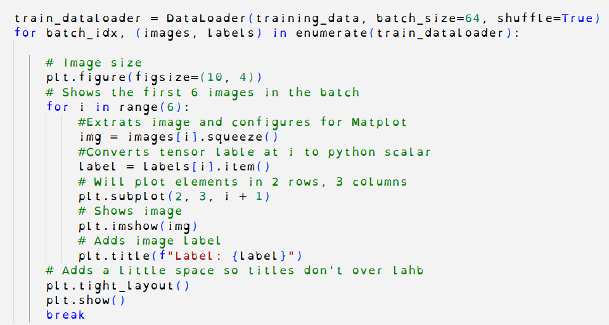
Datasets & Data Loaders
Notes:
Citation: Datasets & DataLoaders — PyTorch Tutorials 2.7.0+cu126 documentation. (n.d.). https://docs.pytorch.org/tutorials/beginner/basics/data_tutorial.html
Let’s take a look at the code!
In the first part, we’re importing the MNIST dataset — a collection of grayscale images of handwritten digits commonly used for training and testing models.
We're using torchvision, which is PyTorch’s computer vision library, to load the dataset. We pull in both the training data (for the model to learn from) and the test data (to evaluate how well the model performs on unseen examples).
In the second part, things get a bit more involved. We're using the DataLoader (imports not shown) to wrap the training_data.
We set the batch_size to 64, which means each iteration will give us 64 images and labels at a time. We also set shuffle=True to randomize the order of the data each epoch, which helps prevent the model from memorizing the sequence.
Finally, we loop through one of those batches and plot the first few images and their labels to visualize what the model is seeing.

Slide 13
Transform Introduction
transform applies changes to input data
target_transform applies changes to labels
Common tools include:
ToTensor() – converts images to tensors
Lambda – defines custom, inline transformations
Notes:
Transforms — PyTorch Tutorials 2.7.0+cu126 documentation. (n.d.). https://docs.pytorch.org/tutorials/beginner/basics/transforms_tutorial.html
To process data and extract meaningful results, we often need to convert or reshape it into a format that’s more suitable for our task. That’s where PyTorch’s transforms come in.
The transform and target_transform parameters in a dataset allow us to apply preprocessing steps to the input data and labels, respectively. When used with tools like ToTensor() and Lambda (a small, anonymous function), we can easily convert, normalize, or customize our data to fit the needs of our model.

Slide 14
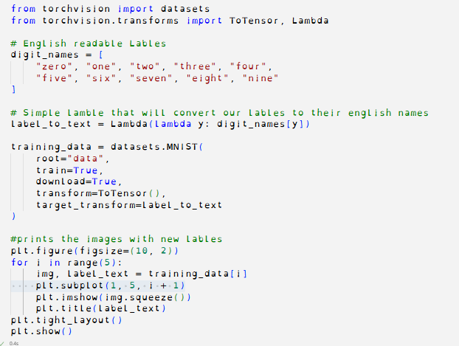
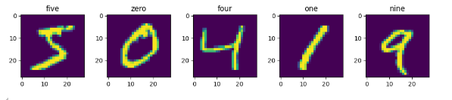
Transform Example
Notes:
Citations: Transforms — PyTorch Tutorials 2.7.0+cu126 documentation. (n.d.). https://docs.pytorch.org/tutorials/beginner/basics/transforms_tutorial.html
In this example, we’re using a lambda function to convert numeric labels into human-readable strings (like "zero" or "five"). While this is a simple use case, transforms in PyTorch can serve a wide variety of purposes.
We start by creating an array of readable label names. Then, we define a lambda function that takes a numeric label and returns the corresponding string from the array.
When loading the dataset:
We use transform=ToTensor() to convert the image data into a scaled PyTorch tensor.
We use target_transform= to apply our lambda function to each label.
The rest of the code handles displaying a few sample images along with their new readable labels.

Slide 15
Building Neural Networks
Neural Networks in PyTorch (Quick Overview)
Neural networks = layers that transform data
Defined by subclassing nn.Module
Accelerators (torch.device) Run models faster on:
CUDA – NVIDIA GPUs (best support)
MPS – Apple Silicon (macOS, partial)
MTIA / XPU – Meta/Intel (limited)
Basic Steps
Define model (nn.Module)
Move to device: model.to(torch.device("cuda"))
Train with DataLoader + optimizer
Notes:
Build the Neural Network — PyTorch Tutorials 2.7.0+cu126 documentation. (n.d.). https://docs.pytorch.org/tutorials/beginner/basics/buildmodel_tutorial.html
Neural Networks in PyTorch
Neural networks are built from layers that perform operations on your data. PyTorch provides the tools to define and train these models using its torch.nn module.
To build a neural network in PyTorch, you’ll also need to select an accelerator—a torch.device that tells PyTorch where to run the model for faster computation. Accelerators include:
CUDA: For NVIDIA GPUs (Linux and Windows). Fully supported and highly recommended.
MPS: For Apple Silicon GPUs (Mac only). Partially supported.
MTIA: Meta’s internal AI hardware (not generally available).
XPU: Intel GPUs. Cross-platform, but support is still limited.
Once your device is selected, you can:
Define your neural network as a Python class that inherits from nn.Module.
Move the model to your selected device using .to(device) so that it runs on your GPU (or CPU fallback).
Train the model using a DataLoader and an optimizer (e.g., SGD, Adam).

Slide 16
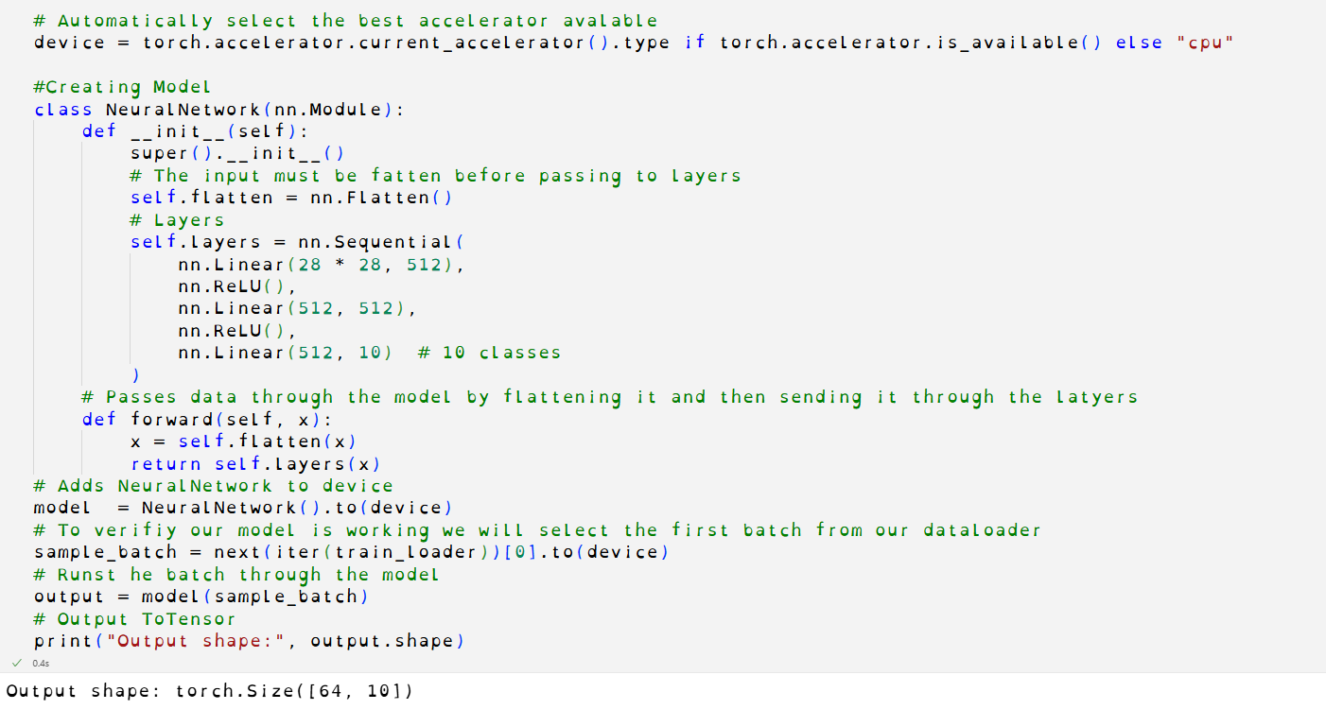
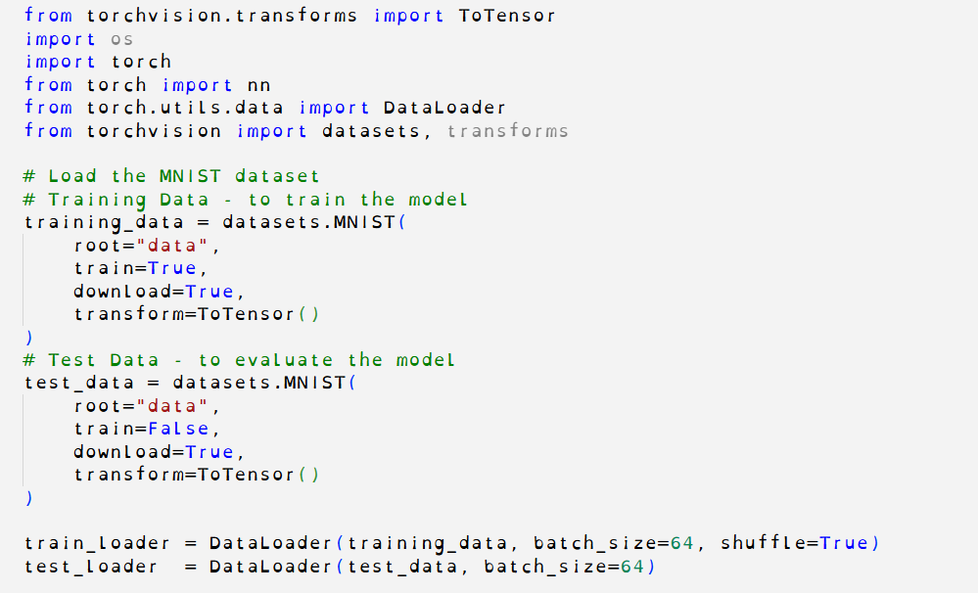
Building Neural Networks

Slide 17
Training Neural Networks
Forward Pass
Get predictions
Compute Loss
Measure the error
Backward Pass (Autograd)
Compute gradients
Update Weights
Typically done with an optimizer
Reset Gradients
Ready for next batch
Notes:
Citation: Automatic Differentiation with torch.autograd — PyTorch Tutorials 2.7.0+cu126 documentation. (n.d.). https://docs.pytorch.org/tutorials/beginner/basics/autogradqs_tutorial.html
Training Neural Networks
Neural networks can be trained using many approaches, but in this example, we’re focusing on backpropagation — a widely used algorithm that adjusts a model’s weights based on the gradient of a loss function.
PyTorch uses a built-in engine called torch.autograd, which automatically computes these gradients for you.
The Training Process:
Forward Pass Run input data through the model to generate predictions.
Compute Loss Use a loss function to measure how far off the predictions are from the actual values.
Backward Pass (Autograd) Call .backward() on the loss to compute gradients of all learnable parameters.
Update Weights (not shown) Typically done with an optimizer like SGD or Adam.
Reset Gradients Clear the gradients using .zero_grad() before the next step.

Slide 18
Optimization
Optimization loop
Training loop
Test loop
Hyperparameters
Epochs
Batch Size
Learning rate
Optimizers
SGD
Adam
RMSprop
Adagarad
Rprop
LBFGS ...etc.
Notes:
Citation: Optimizing Model Parameters — PyTorch Tutorials 2.7.0+cu126 documentation. (n.d.). https://docs.pytorch.org/tutorials/beginner/basics/optimization_tutorial.html
One of the key steps in training a neural network is updating the model’s weights using gradient descent. This is handled by the optimizer loop.
Before diving into the loop, it’s important to understand the hyperparameters adjustable settings that control how the model learns:
Epochs – How many times the model iterates through the dataset
Batch size – How many samples are processed before the model updates its parameters
Learning rate – How much the model's weights are adjusted during each update
These hyperparameters guide the structure of the optimization loop, which typically includes:
A training loop: where the model learns by minimizing the loss
A test loop: where we evaluate performance on unseen data to check for improvement
Finally, the optimizer is the algorithm that performs the actual weight updates. PyTorch offers several options, including:
SGD (Stochastic Gradient Descent)
Adam
RMSprop
Each has its strengths depending on the dataset and task.

Slide 19
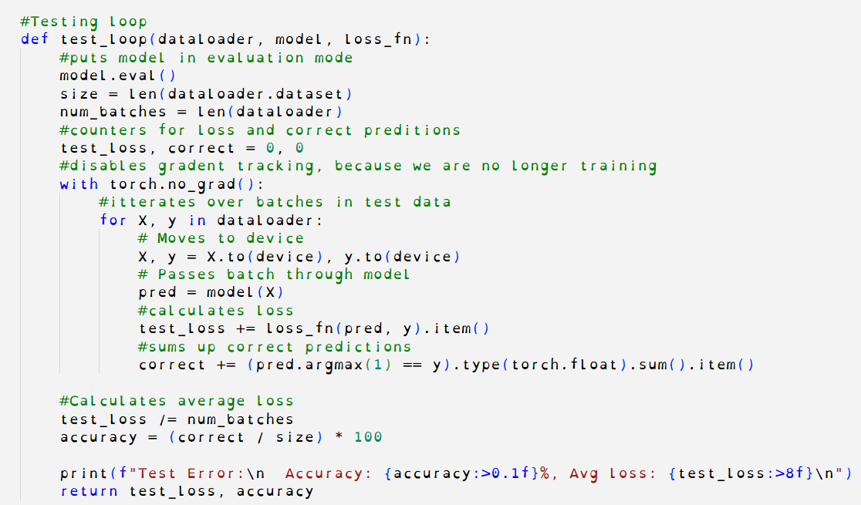
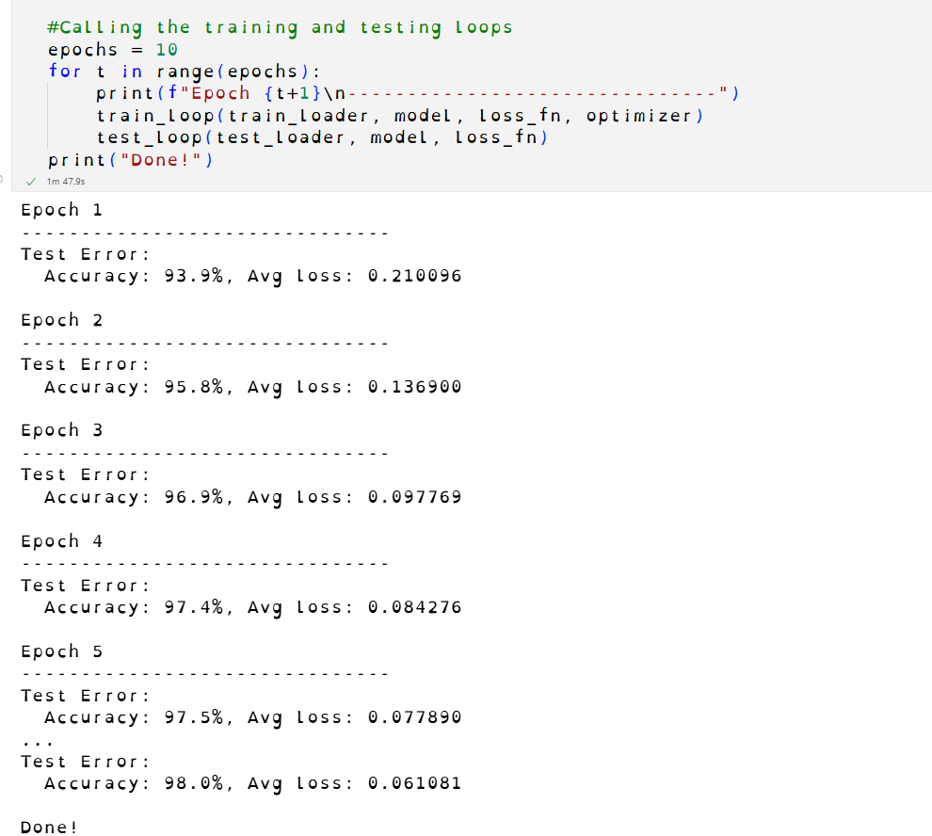
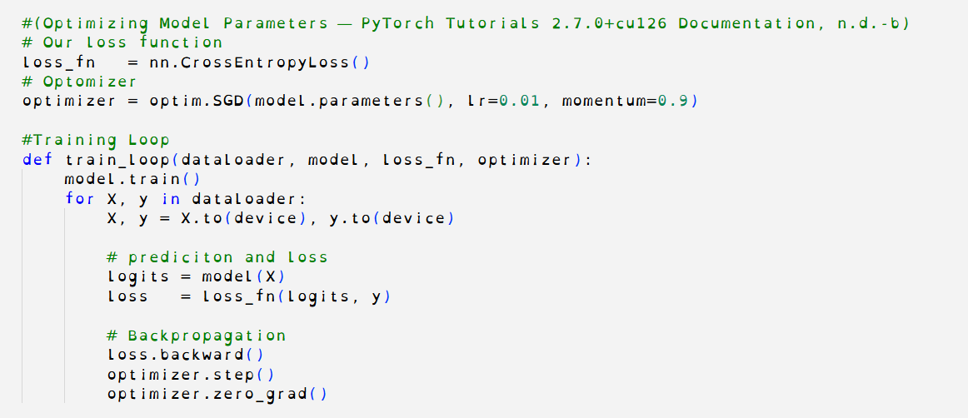
Training Example
Notes:
Citation: Optimizing Model Parameters — PyTorch Tutorials 2.7.0+cu126 documentation. (n.d.-b). https://docs.pytorch.org/tutorials/beginner/basics/optimization_tutorial.html

Slide 20
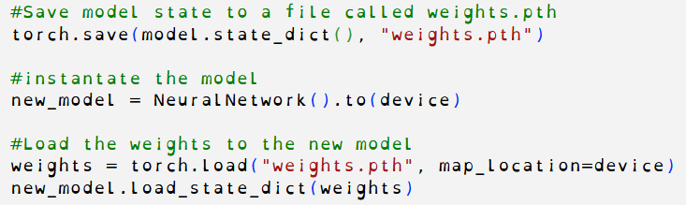
Save, Load & Use Model
Save model weights
torch.save
state_dict
Load saved weights
load_state_dict
Notes:
Save and Load the Model — PyTorch Tutorials 2.7.0+cu126 documentation. (n.d.). https://docs.pytorch.org/tutorials/beginner/basics/saveloadrun_tutorial.html
To store and reuse a trained model, we can save its learned parameters using torch.save(). This creates a file containing the model’s state_dict, which holds all the weights and biases.
To load the model later, we:
Recreate the model architecture.
Use load_state_dict() to load the saved parameters into it.
This allows us to resume training or run predictions without retraining the model from scratch.

Slide 21
Tutorial
on GitHub
https://github.com/HiromiCota/CS506_TeamProject/tree/vero
Notes:
“Our Dance Moves Detector shows how we used PyTorch not just to classify movement—but to visualize it, track it, and trigger real-time events from it.”
https://github.com/HiromiCota/CS506_TeamProject/tree/vero

Slide 22
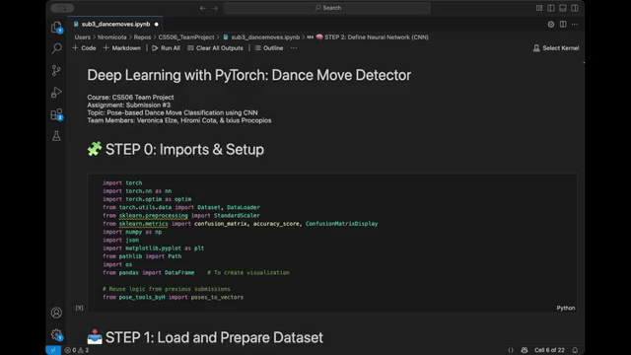
Demo
Repository:
https://github.com/HiromiCota/CS506_TeamProject/tree/vero

Slide 23

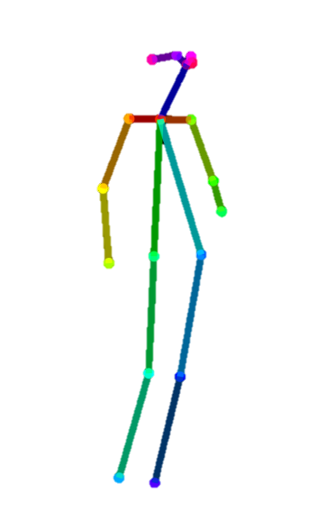
Applications
Dance Move Detection
Choreography Feedback
Movement Tracking
Physical Therapy
Interactive Games
Surveillance Analytics
Event Detection
Initial standing pose
to
Dance kick pose
Kick move detected!
Notes:
Our PyTorch-based Dance Moves Detector opens the door to a wide range of practical applications.
We start with Dance Move Detection, like identifying a kick or a spin from pose transitions—just like you see in the visual where a kick is automatically detected.
From there, we can support Choreography Feedback, giving real-time insights to dancers during training.
Movement Tracking and Physical Therapy use the same foundation to monitor body motion or rehab progress.
In the creative space, Interactive Games can react to dance moves for gesture-based play, while Surveillance Analytics could track motion patterns in larger settings.
Finally, with Event Detection, specific moves can trigger system responses like sound effects, scoring, or alerts—making this tool both flexible and fun across industries.

Slide 24
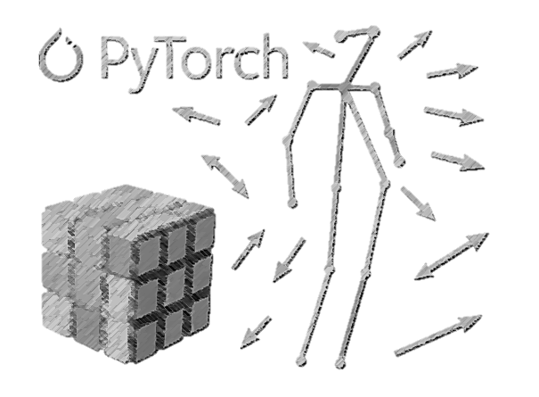


Thank you!
Ixius Procopios
MS in CS
Verónica Elze
MS of AI
Hiromi Cota
MS of AI

Slide 25
References
OpenAI. (2025). ChatGPT’s assistance with CS506 TP03 Dance Detector [Large language model]. https://openai.com/chatgpt
PyTorch. (n.d.). https://pytorch.org/docs/stable/index.html
Scikit-Learn. (n.d.). StandardScaler, accuracy_score, confusion_matrix. https://scikit-learn.org/stable/modules/classes.html
Image citation: Rojewska, K. (2024, March 8). What are Neural Networks and What are Their Applications? Qtravel.ai. https://www.qtravel.ai/blog/what-are-neural-networks-and-what-are-their-applications/
Other citations: Daniel Bourke. (2022, July 24). Learn PyTorch for deep learning in a day. Literally. [Video]. YouTube. https://www.youtube.com/watch?v=Z_ikDlimN6A
Tensors — PyTorch Tutorials 2.7.0+cu126 documentation. (n.d.). https://docs.pytorch.org/tutorials/beginner/basics/tensorqs_tutorial.html
Datasets & DataLoaders — PyTorch Tutorials 2.7.0+cu126 documentation. (n.d.). https://docs.pytorch.org/tutorials/beginner/basics/data_tutorial.html
Transforms — PyTorch Tutorials 2.7.0+cu126 documentation. (n.d.). https://docs.pytorch.org/tutorials/beginner/basics/transforms_tutorial.html
Build the Neural Network — PyTorch Tutorials 2.7.0+cu126 documentation. (n.d.). https://docs.pytorch.org/tutorials/beginner/basics/buildmodel_tutorial.html
Automatic Differentiation with torch.autograd — PyTorch Tutorials 2.7.0+cu126 documentation. (n.d.). https://docs.pytorch.org/tutorials/beginner/basics/autogradqs_tutorial.html
Optimizing Model Parameters — PyTorch Tutorials 2.7.0+cu126 documentation. (n.d.). https://docs.pytorch.org/tutorials/beginner/basics/optimization_tutorial.html
Save and Load the Model — PyTorch Tutorials 2.7.0+cu126 documentation. (n.d.). https://docs.pytorch.org/tutorials/beginner/basics/saveloadrun_tutorial.html

